Slide 1
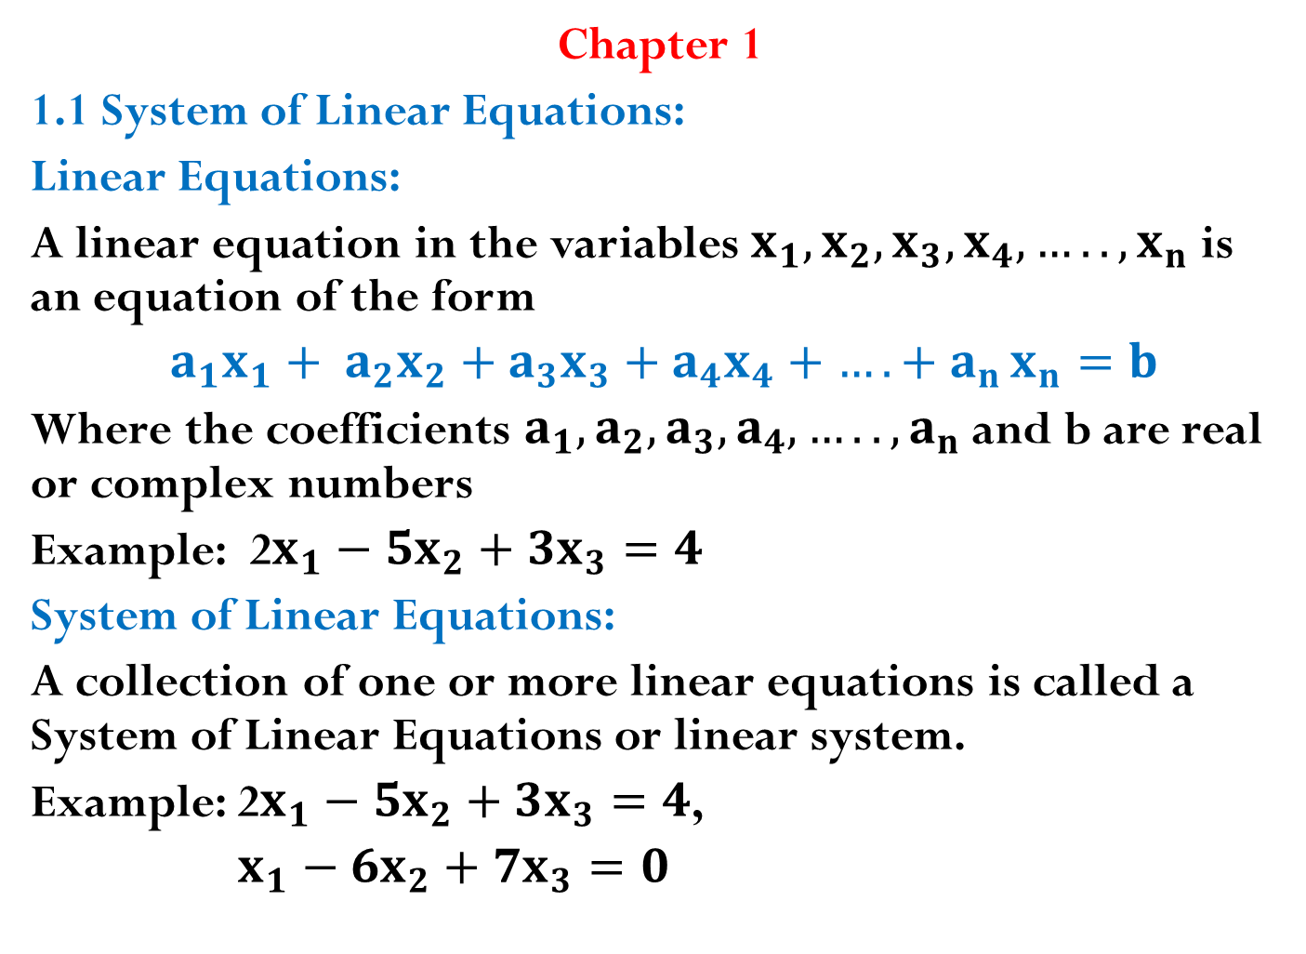
Chapter 1
1.1 System of Linear Equations:
Linear Equations:
A linear equation in the variables $x_{1},x_{2}, x_{3},x_{4}, ….., x_{n}$is an equation of the form
$a_{1}x_{1}+ a_{2}x_{2}+a_{3}x_{3}+a_{4}x_{4}+{…. + a}_{n}x_{n}=b$
Where the coefficients $a_{1},a_{2}, a_{3},a_{4}, ….., a_{n}$ and b are real or complex numbers
Example: 2$x_{1}−5x_{2}+3x_{3}=4$
System of Linear Equations:
A collection of one or more linear equations is called a System of Linear Equations or linear system.
Example: 2$x_{1}−5x_{2}+3x_{3}=4$,
$x_{1}−6x_{2}+{7x}_{3}=0$

Slide 2
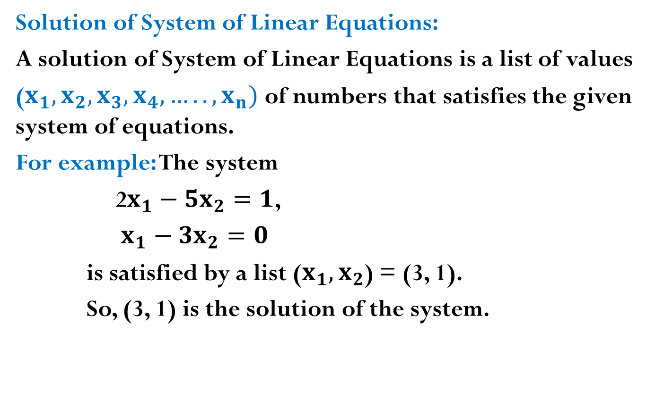
Solution of System of Linear Equations:
A solution of System of Linear Equations is a list of values
($x_{1},x_{2}, x_{3},x_{4}, ….., x_{n})$ of numbers that satisfies the given system of equations.
For example: The system
2$x_{1}−5x_{2}=1$,
$x_{1}−3x_{2}=0$
is satisfied by a list ($x_{1},x_{2}$) = (3, 1).
So, (3, 1) is the solution of the system.

Slide 3
Consistent and inconsistent :
A system of linear equations is called consistent if it has one or more than one or infinitely many solutions and called inconsistent if it has no solution.
Matrix notation of the system:
A matrix form of coefficients and the constant values of a linear system of equations is known as matrix notation of the system.
If the matrix notation involves only the coefficients of variable then the system is called coefficient matrix. And if, the matrix notation involves the coefficients of linear system as well as constant value then the matrix is called augmented matrix of the system.

Slide 4
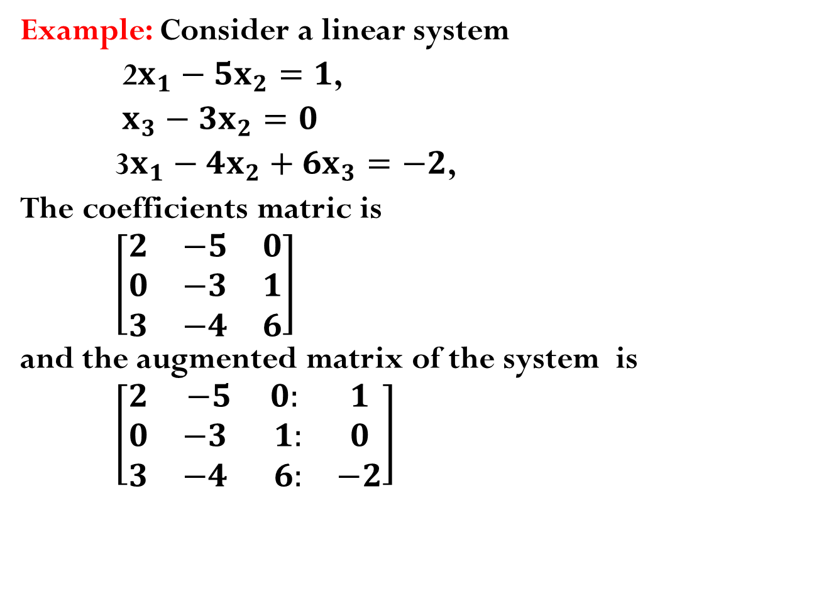
Example: Consider a linear system
2$x_{1}−5x_{2}=1$,
$x_{3}−3x_{2}=0$
3$x_{1}−4x_{2}+{6x}_{3}=−2$,
The coefficients matric is
$\left[\begin{matrix}2 & −5 & 0 \\ 0 & −3 & 1 \\ 3 & −4 & 6\end{matrix}\right]$
and the augmented matrix of the system is
$\left[\begin{matrix}2 & −5 0: & 1 \\ 0 & −3 1: & 0 \\ 3 & −4 6: & −2\end{matrix}\right]$

Slide 5
Elementary row operations:
Replacement (replace one row by the sum of itself and a multiple of another row)
Interchange (interchange of two rows)
Scaling (Multiply all entries in a row by a nonzero constant.
Echelon form or Row Echelon form:
A rectangular matrix is in Echelon form (or row echelon form) if it has the following three properties:
All non-zero rows are above any rows of all zeros.
Each leading entry of a row is in a column to the right of the leading entry of the row above it.
All entries in a column below a leading entry are zeros.
If a matrix is in echelon form and satisfies the conditions
4) The leading entry in each non-zero row is 1.
5) Each leading 1 is the only non-zero entry in its column.

Slide 6
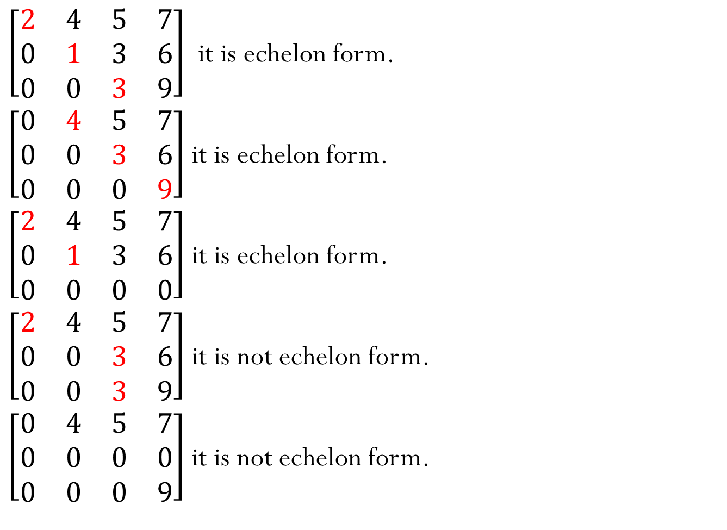
$\left[\begin{matrix}2 & 4 & 5 & 7 \\ 0 & 1 & 3 & 6 \\ 0 & 0 & 3 & 9\end{matrix}\right]$ it is echelon form.
$\left[\begin{matrix}0 & 4 & 5 & 7 \\ 0 & 0 & 3 & 6 \\ 0 & 0 & 0 & 9\end{matrix}\right]$ it is echelon form.
$\left[\begin{matrix}2 & 4 & 5 & 7 \\ 0 & 1 & 3 & 6 \\ 0 & 0 & 0 & 0\end{matrix}\right]$ it is echelon form.
$\left[\begin{matrix}2 & 4 & 5 & 7 \\ 0 & 0 & 3 & 6 \\ 0 & 0 & 3 & 9\end{matrix}\right]$ it is not echelon form.
$\left[\begin{matrix}0 & 4 & 5 & 7 \\ 0 & 0 & 0 & 0 \\ 0 & 0 & 0 & 9\end{matrix}\right]$ it is not echelon form.

Slide 7
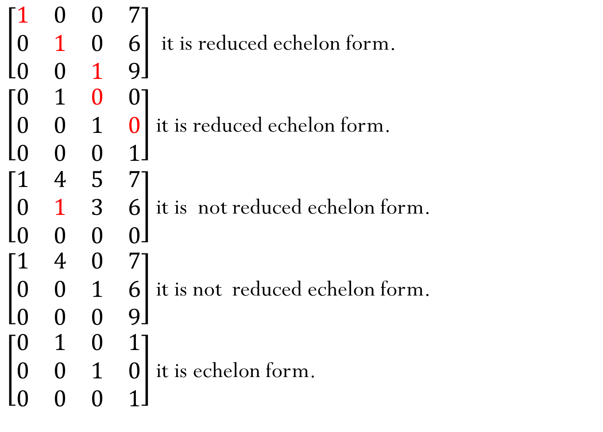
$\left[\begin{matrix}1 & 0 & 0 & 7 \\ 0 & 1 & 0 & 6 \\ 0 & 0 & 1 & 9\end{matrix}\right]$ it is reduced echelon form.
$\left[\begin{matrix}0 & 1 & 0 & 0 \\ 0 & 0 & 1 & 0 \\ 0 & 0 & 0 & 1\end{matrix}\right]$ it is reduced echelon form.
$\left[\begin{matrix}1 & 4 & 5 & 7 \\ 0 & 1 & 3 & 6 \\ 0 & 0 & 0 & 0\end{matrix}\right]$ it is not reduced echelon form.
$\left[\begin{matrix}1 & 4 & 0 & 7 \\ 0 & 0 & 1 & 6 \\ 0 & 0 & 0 & 9\end{matrix}\right]$ it is not reduced echelon form.
$\left[\begin{matrix}0 & 1 & 0 & 1 \\ 0 & 0 & 1 & 0 \\ 0 & 0 & 0 & 1\end{matrix}\right]$ it is echelon form.

Slide 8
Note:
Different operations of row operation gives different echelon matrix of any non-zero matrix. This means a matrix may have more than one echelon matrix as the operated row operations.
Remembered that a non-zero matrix have one and only one i.e. exactly one reduced echelon matrix
Theorem 1 (Uniqueness of the Reduced echelon form)
Each matrix is row equivalent to one and only one reduced echelon matrix.

Slide 9
Pivot position in reduced echelon form:
A pivot position in a matrix A is a location in A that corresponds to a leading 1 in the reduced echelon form of A. A pivot column is a column of A that contains a pivot position.

Slide 10
Row reduction Algorithm:
The algorithm helps to obtain a matrix in echelon form and in reduced echelon form.
The process of the algorithm is as follows:
Begin with the leftmost nonzero column. This is a pivot column. The pivot position is at the top.
Select the nonzero entry in the pivot column as a pivot. If necessary , interchange rows to move this entry into the pivot position.
Use row replacement operations to create zeros in all positions below the pivot.
Cover (or ignore) the row containing the pivot position and cover all rows, if any, above it. Apply steps 1-3 to the sub matrix that remains. Repeat the process until there are no more nonzero rows to modify.
Beginning with the rightmost pivot and working upward and to the left, create zeros above each pivot. If a pivot is not 1, make it 1 by scaling operation.

Slide 11
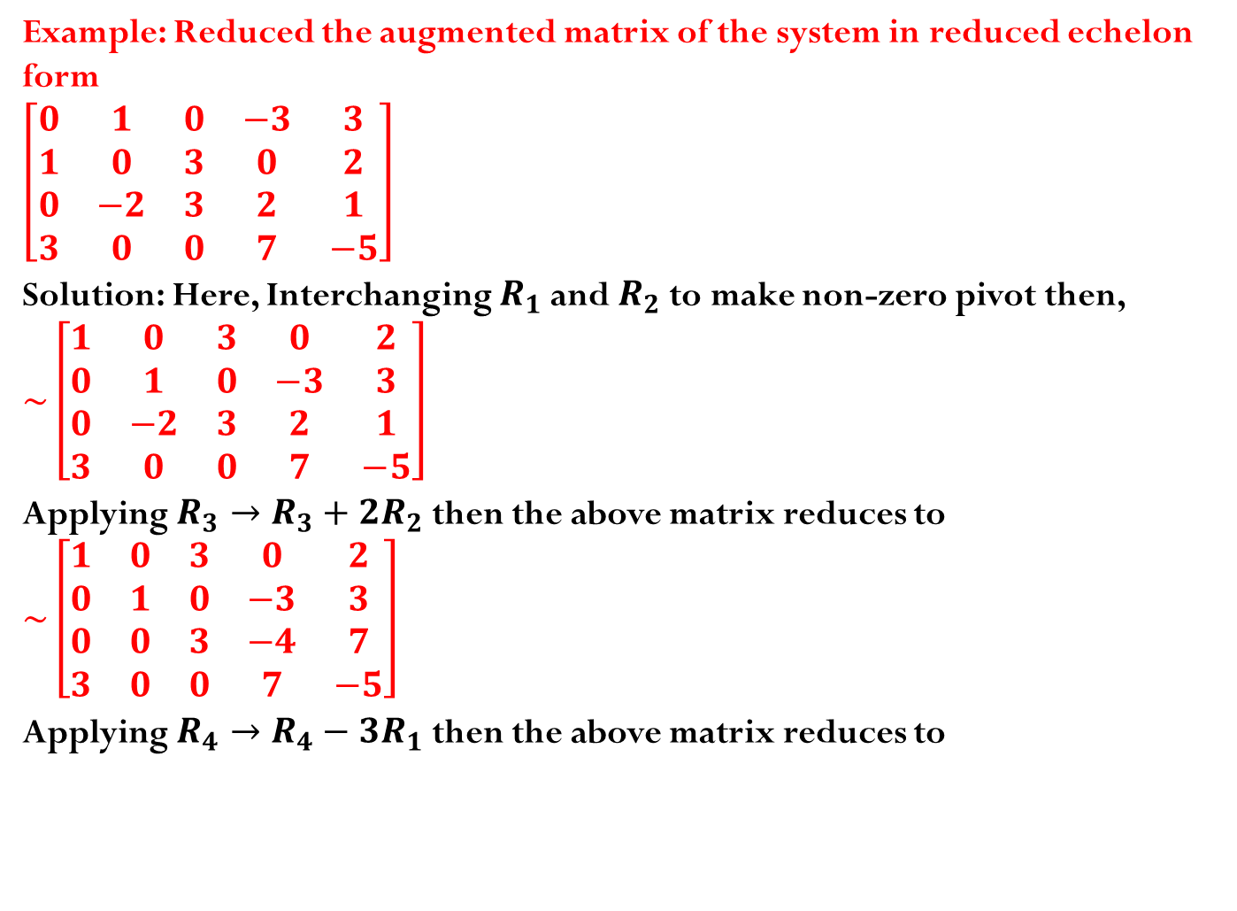
Example: Reduced the augmented matrix of the system in reduced echelon form
$$\left[\begin{matrix}0 & 1 & 0 & −3 & 3 \\ 1 & 0 & 3 & 0 & 2 \\ 0 & −2 & 3 & 2 & 1 \\ 3 & 0 & 0 & 7 & −5\end{matrix}\right]$$
Solution: Here, Interchanging $R_{1}$ and $R_{2}$ to make non-zero pivot then,
$$\sim \left[\begin{matrix}1 & 0 & 3 & 0 & 2 \\ 0 & 1 & 0 & −3 & 3 \\ 0 & −2 & 3 & 2 & 1 \\ 3 & 0 & 0 & 7 & −5\end{matrix}\right]$$
Applying $R_{3}→R_{3}+2R_{2}$ then the above matrix reduces to
$$\sim \left[\begin{matrix}1 & 0 & 3 & 0 & 2 \\ 0 & 1 & 0 & −3 & 3 \\ 0 & 0 & 3 & −4 & 7 \\ 3 & 0 & 0 & 7 & −5\end{matrix}\right]$$
Applying $R_{4}→R_{4}−3R_{1}$ then the above matrix reduces to

Slide 12
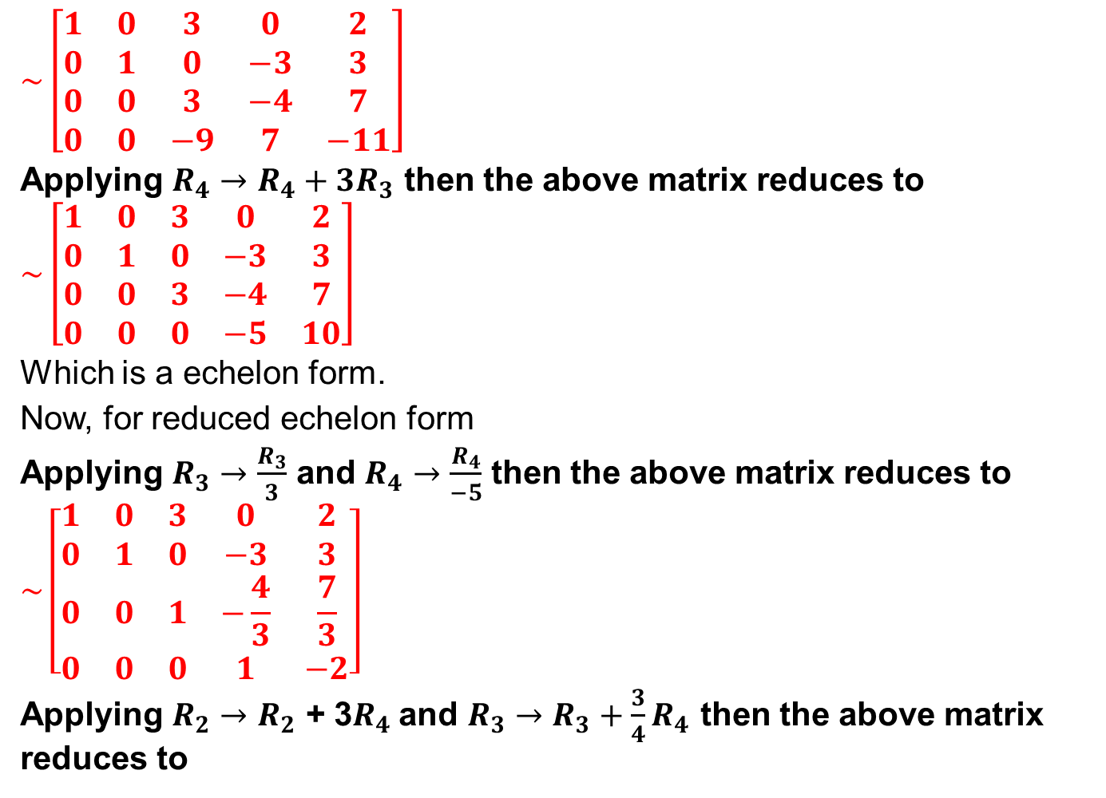
$$\sim \left[\begin{matrix}1 & 0 & 3 & 0 & 2 \\ 0 & 1 & 0 & −3 & 3 \\ 0 & 0 & 3 & −4 & 7 \\ 0 & 0 & −9 & 7 & −11\end{matrix}\right]$$
Applying $R_{4}→R_{4}+3R_{3}$ then the above matrix reduces to
$$\sim \left[\begin{matrix}1 & 0 & 3 & 0 & 2 \\ 0 & 1 & 0 & −3 & 3 \\ 0 & 0 & 3 & −4 & 7 \\ 0 & 0 & 0 & −5 & 10\end{matrix}\right]$$
Which is a echelon form.
Now, for reduced echelon form
Applying $R_{3}→\frac{R_{3}}{3}$ and $R_{4}→\frac{R_{4}}{−5}$ then the above matrix reduces to
$$\sim \left[\begin{matrix}1 & 0 & 3 & 0 & 2 \\ 0 & 1 & 0 & −3 & 3 \\ 0 & 0 & 1 & −\frac{4}{3} & \frac{7}{3} \\ 0 & 0 & 0 & 1 & −2\end{matrix}\right]$$
Applying $R_{2}→R_{2}$ + 3$R_{4}$and $R_{3}→R_{3}+\frac{3}{4}R_{4}$ then the above matrix reduces to

Slide 13
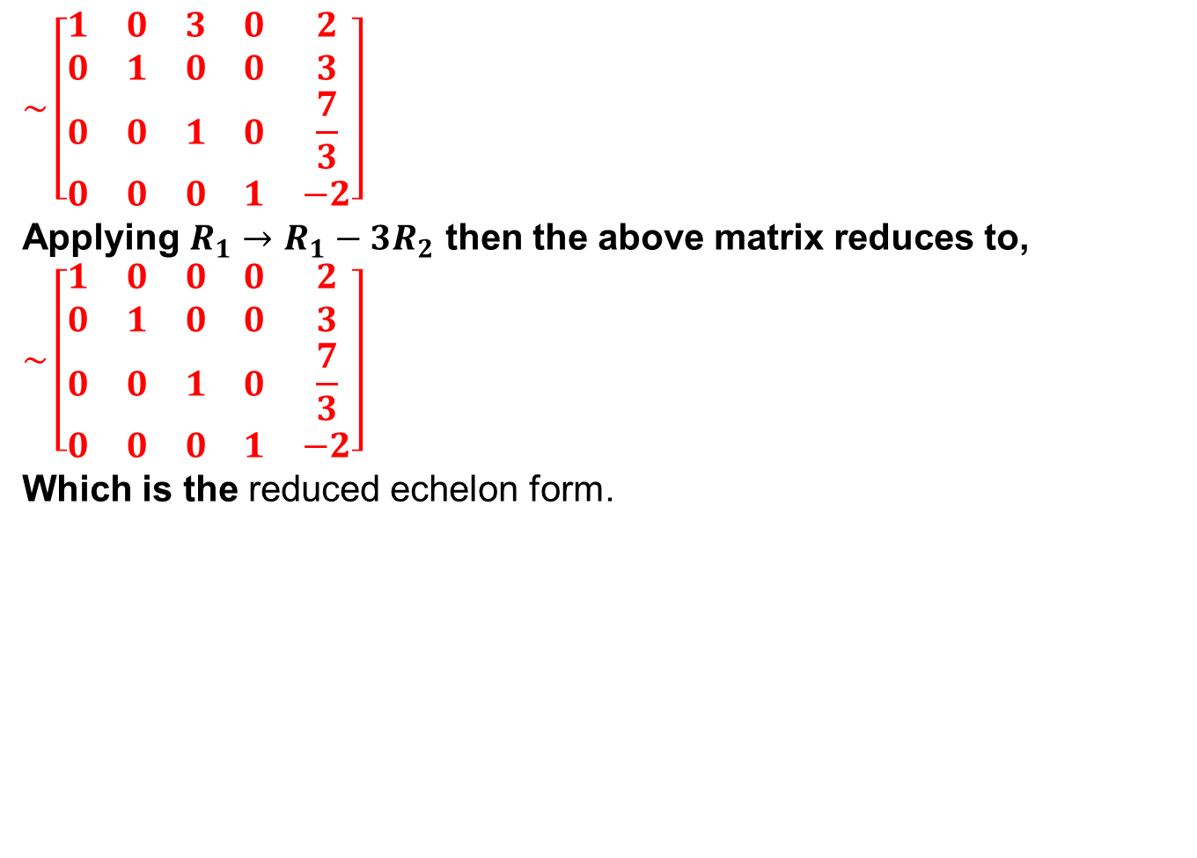
$$\sim \left[\begin{matrix}1 & 0 & 3 & 0 & 2 \\ 0 & 1 & 0 & 0 & 3 \\ 0 & 0 & 1 & 0 & \frac{7}{3} \\ 0 & 0 & 0 & 1 & −2\end{matrix}\right]$$
Applying $R_{1}→R_{1}−3R_{2}$ then the above matrix reduces to,
$$\sim \left[\begin{matrix}1 & 0 & 0 & 0 & 2 \\ 0 & 1 & 0 & 0 & 3 \\ 0 & 0 & 1 & 0 & \frac{7}{3} \\ 0 & 0 & 0 & 1 & −2\end{matrix}\right]$$
Which is the reduced echelon form.

Slide 14
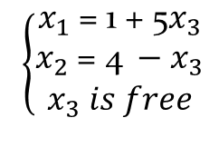
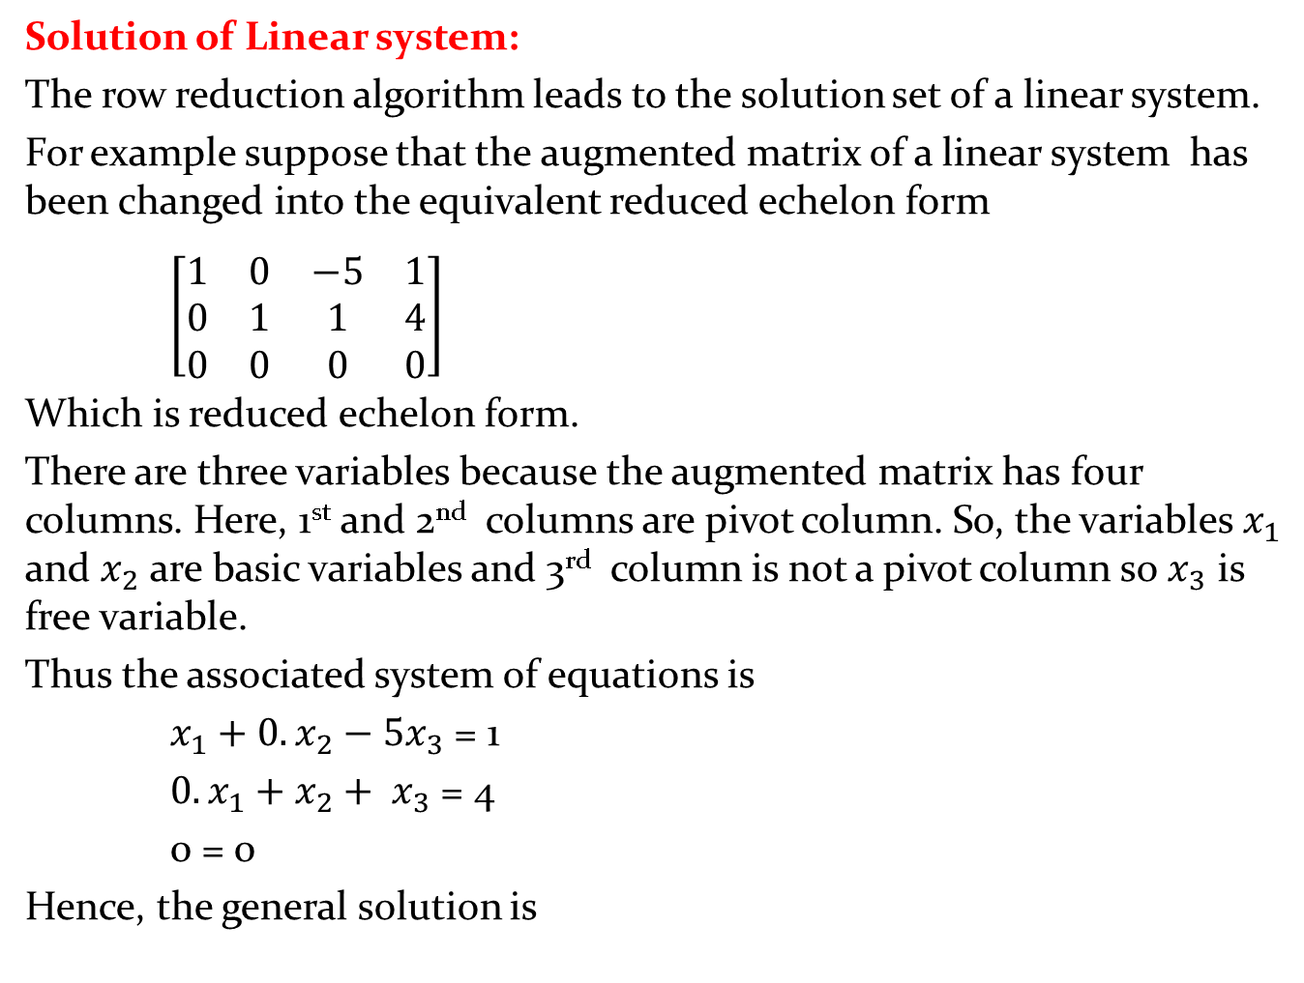
Solution of Linear system:
The row reduction algorithm leads to the solution set of a linear system.
For example suppose that the augmented matrix of a linear system has been changed into the equivalent reduced echelon form
$\left[\begin{matrix}1 & 0 & −5 & 1 \\ 0 & 1 & 1 & 4 \\ 0 & 0 & 0 & 0\end{matrix}\right]$
Which is reduced echelon form.
There are three variables because the augmented matrix has four columns. Here, 1st and 2nd columns are pivot column. So, the variables $x_{1}$ and $x_{2}$ are basic variables and 3rd column is not a pivot column so $x_{3}$ is free variable.
Thus the associated system of equations is
$x_{1}+0.x_{2}−5x_{3}$ = 1
${0.x}_{1}+x_{2}+ x_{3}$ = 4
0 = 0
Hence, the general solution is
$\left\{\begin{aligned}x_{1} \text{= 1}\text{ + 5}x_{3} \\ x_{2} \text{= 4} −x_{3} \\ x_{3} is free\end{aligned}\right.$

Slide 15
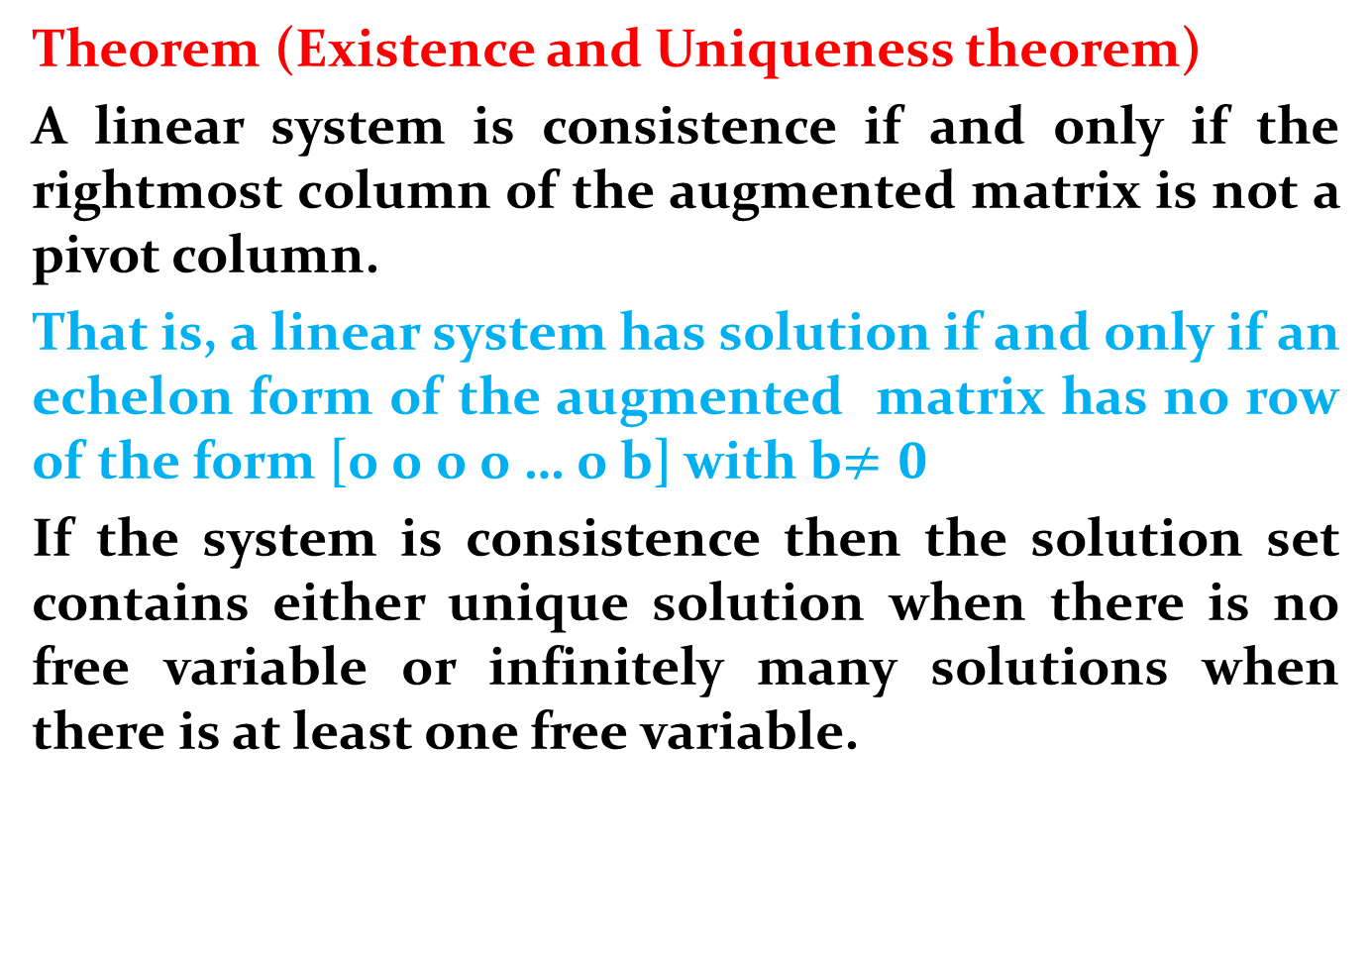
Theorem (Existence and Uniqueness theorem)
A linear system is consistence if and only if the rightmost column of the augmented matrix is not a pivot column.
That is, a linear system has solution if and only if an echelon form of the augmented matrix has no row of the form [0 0 0 0 … 0 b] with b$≠0$
If the system is consistence then the solution set contains either unique solution when there is no free variable or infinitely many solutions when there is at least one free variable.

Slide 16
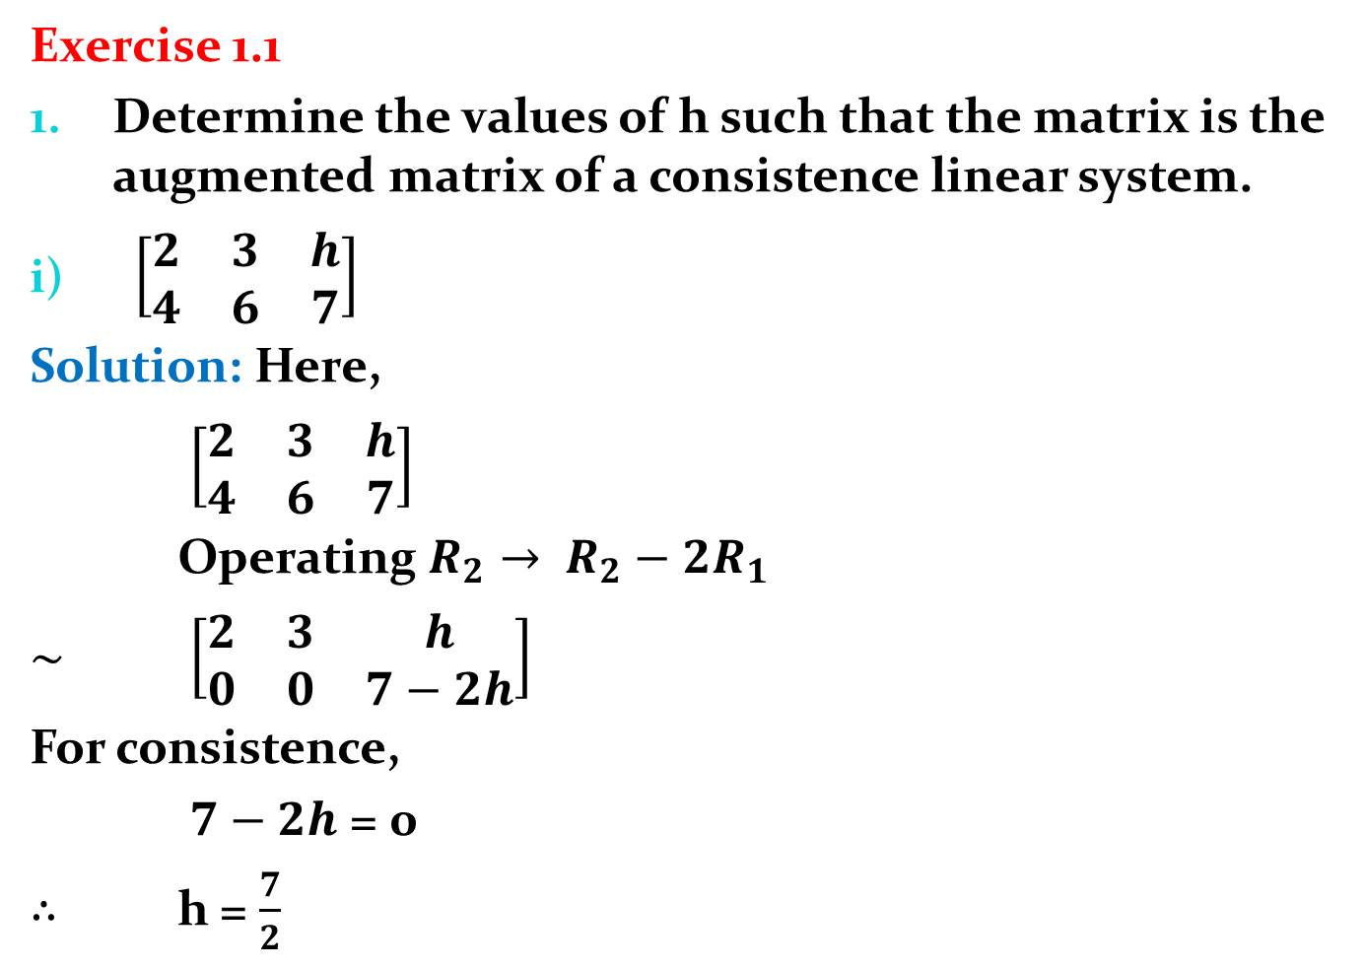
Exercise 1.1
Determine the values of h such that the matrix is the augmented matrix of a consistence linear system.
$\left[\begin{matrix}2 & 3 & h \\ 4 & 6 & 7\end{matrix}\right]$
Solution: Here,
$\left[\begin{matrix}2 & 3 & h \\ 4 & 6 & 7\end{matrix}\right]$
Operating $R_{2}→ R_{2}−2R_{1}$
$\sim$ $\left[\begin{matrix}2 & 3 & h \\ 0 & 0 & 7−2h\end{matrix}\right]$
For consistence,
$7−2h$ = 0
$∴$ h = $\frac{7}{2}$

Slide 17
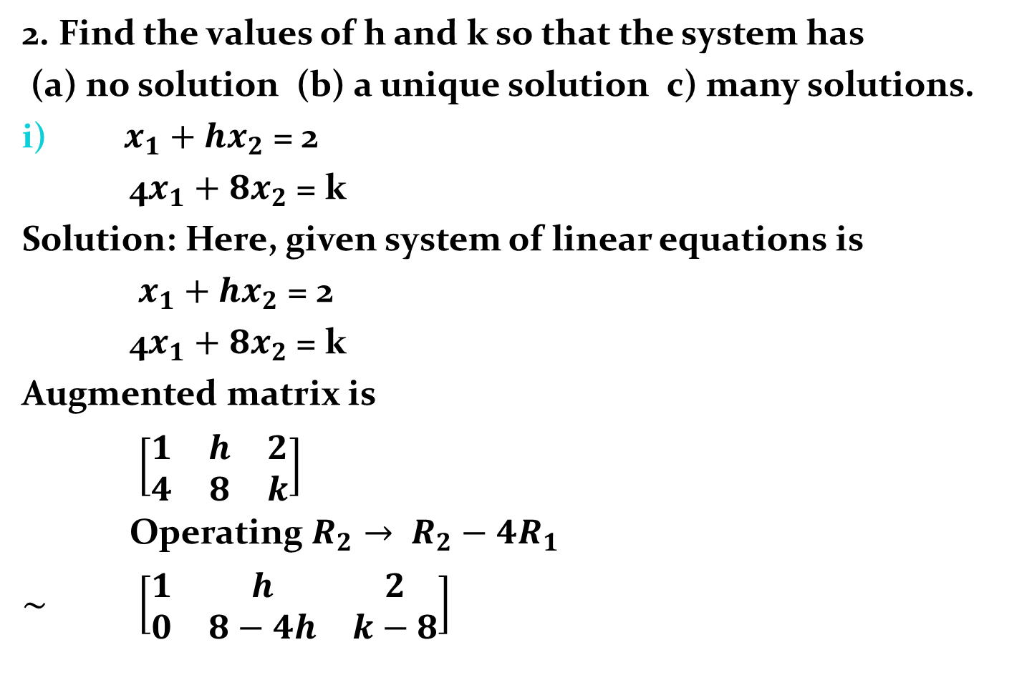
2. Find the values of h and k so that the system has
(a) no solution (b) a unique solution c) many solutions.
$x_{1}+hx_{2}$ = 2
4$x_{1}+8x_{2}$ = k
Solution: Here, given system of linear equations is
$x_{1}+hx_{2}$ = 2
4$x_{1}+8x_{2}$ = k
Augmented matrix is
$\left[\begin{matrix}1 & h & 2 \\ 4 & 8 & k\end{matrix}\right]$
Operating $R_{2}→ R_{2}−4R_{1}$
$\sim$ $\left[\begin{matrix}1 & h & 2 \\ 0 & 8−4h & k−8\end{matrix}\right]$

Slide 18
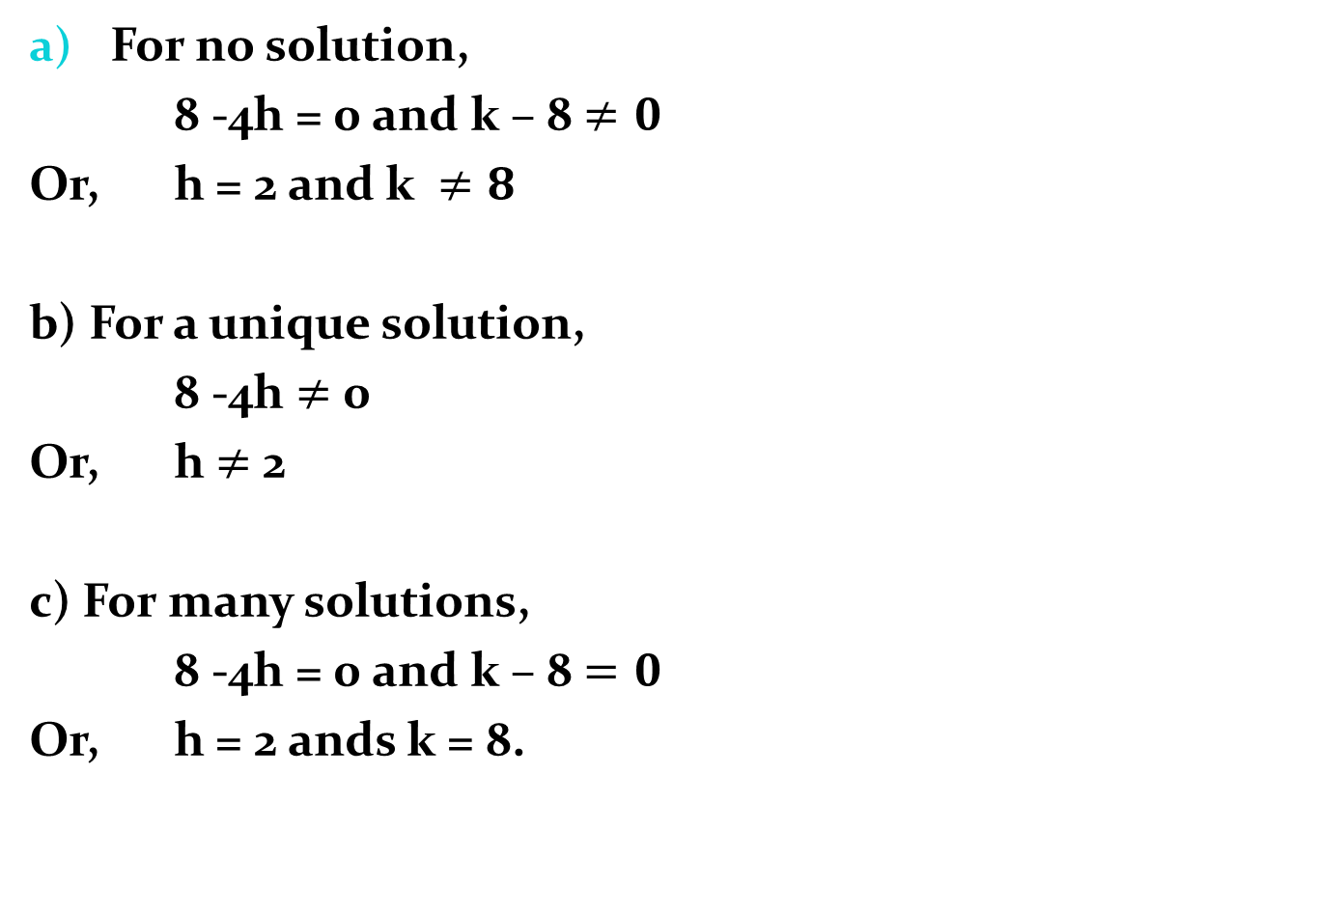
For no solution,
8 -4h = 0 and k – 8 $≠0$
Or, h = 2 and k $≠8$
b) For a unique solution,
8 -4h $≠$ 0
Or, h $≠$ 2
c) For many solutions,
8 -4h = 0 and k – 8 $=0$
Or, h = 2 ands k = 8.

Slide 19
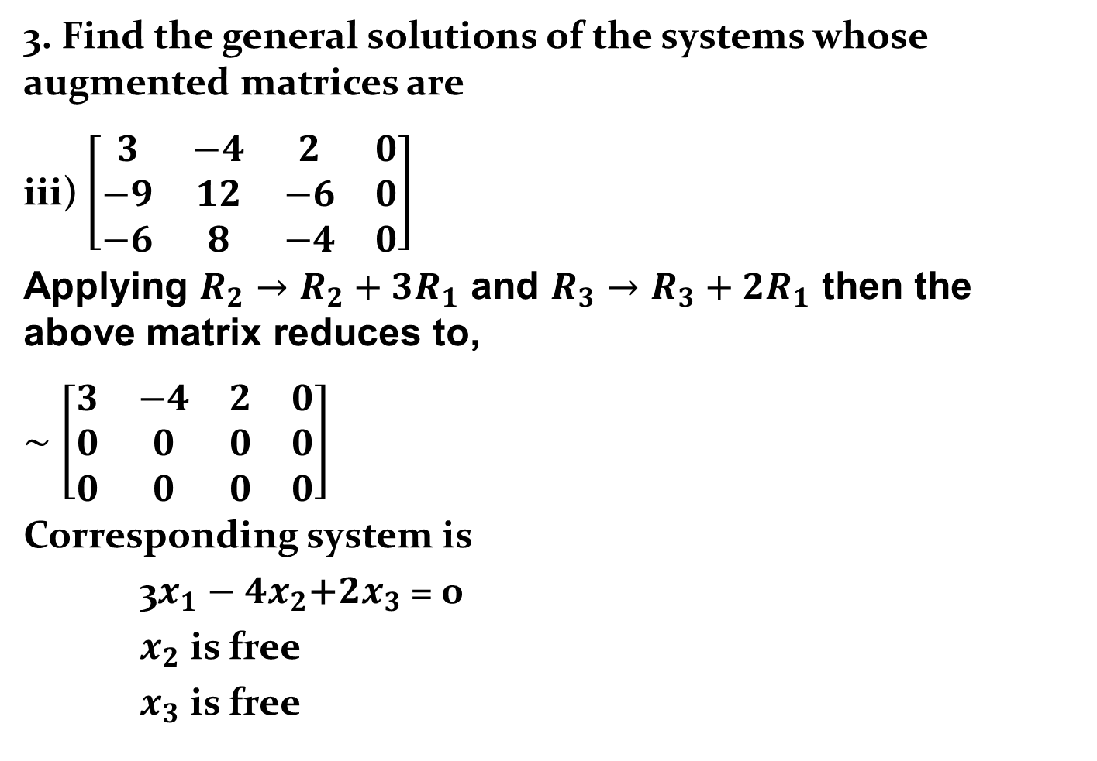
3. Find the general solutions of the systems whose augmented matrices are
iii) $\left[\begin{matrix}3 & −4 & 2 & 0 \\ −9 & 12 & −6 & 0 \\ −6 & 8 & −4 & 0\end{matrix}\right]$
Applying $R_{2}→R_{2}+3R_{1}$ and $R_{3}→R_{3}+2R_{1}$ then the above matrix reduces to,
$\sim$ $\left[\begin{matrix}3 & −4 & 2 & 0 \\ 0 & 0 & 0 & 0 \\ 0 & 0 & 0 & 0\end{matrix}\right]$
Corresponding system is
3$x_{1}−4x_{2}\text{+}2x_{3}\text{ = }$0
$x_{2}$ is free
$x_{3}$ is free

Slide 20

3$x_{1}−4x_{2}\text{+}2x_{3}\text{ = }$0
$x_{2}$ is free
$x_{3}$ is free
$⇒$ $x_{1}$ = $\frac{4x_{2}\text{ − }2x_{3} }{3}$
$x_{2}$ is free
$x_{3}$ is free

Slide 21
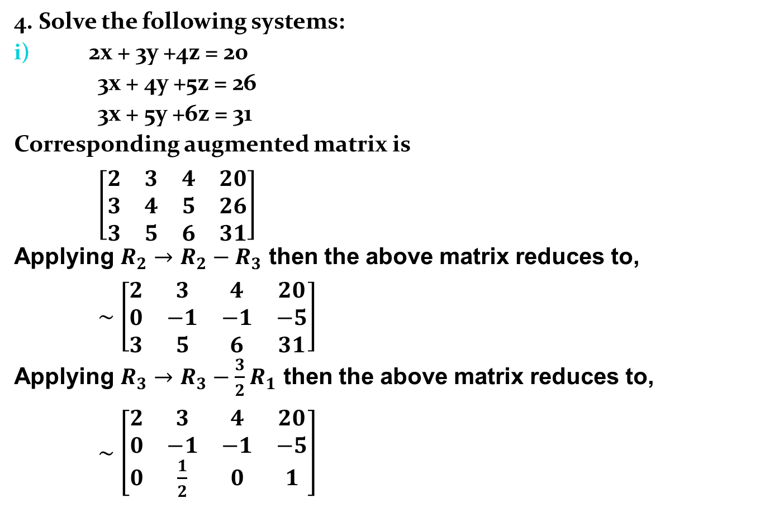
4. Solve the following systems:
2x + 3y +4z = 20
3x + 4y +5z = 26
3x + 5y +6z = 31
Corresponding augmented matrix is
$\left[\begin{matrix}2 & 3 & 4 & 20 \\ 3 & 4 & 5 & 26 \\ 3 & 5 & 6 & 31\end{matrix}\right]$
Applying $R_{2}→R_{2}−R_{3}$ then the above matrix reduces to,
$\sim$ $\left[\begin{matrix}2 & 3 & 4 & 20 \\ 0 & −1 & −1 & −5 \\ 3 & 5 & 6 & 31\end{matrix}\right]$
Applying $R_{3}→R_{3}−\frac{3}{2}R_{1}$ then the above matrix reduces to,
$\sim$ $\left[\begin{matrix}2 & 3 & 4 & 20 \\ 0 & −1 & −1 & −5 \\ 0 & \frac{1}{2} & 0 & 1\end{matrix}\right]$

Slide 22
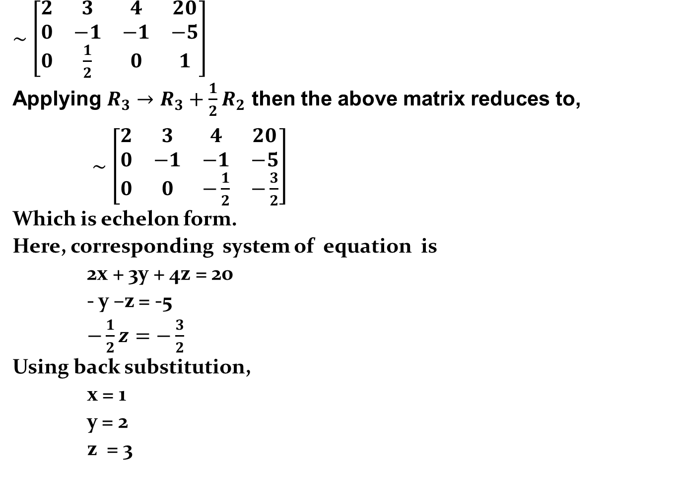
$\sim$ $\left[\begin{matrix}2 & 3 & 4 & 20 \\ 0 & −1 & −1 & −5 \\ 0 & \frac{1}{2} & 0 & 1\end{matrix}\right]$
Applying $R_{3}→R_{3}+\frac{1}{2}R_{2}$ then the above matrix reduces to,
$\sim$ $\left[\begin{matrix}2 & 3 & 4 & 20 \\ 0 & −1 & −1 & −5 \\ 0 & 0 & −\frac{1}{2} & −\frac{3}{2}\end{matrix}\right]$
Which is echelon form.
Here, corresponding system of equation is
2x + 3y + 4z = 20
- y –z = -5
$−\frac{1}{2}z=−\frac{3}{2}$
Using back substitution,
x = 1
y = 2
z = 3

Slide 23
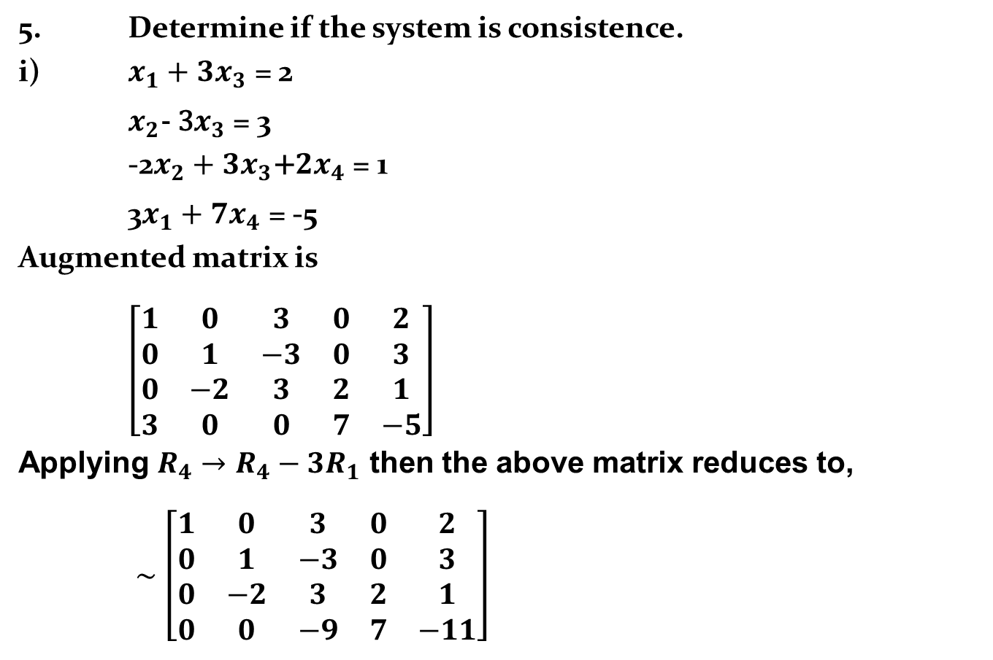
5. Determine if the system is consistence.
i) $x_{1}+3x_{3}\text{ = }\text{2}$
$x_{2}\text{− 3}x_{3}\text{ = }\text{3}$
-2$x_{2}+{3x}_{3}\text{+}2x_{4}\text{ = }\text{1}$
3$x_{1}+7x_{4}\text{ = }\text{−5 }$
Augmented matrix is
$\left[\begin{matrix}1 & 0 & 3 & 0 & 2 \\ 0 & 1 & −3 & 0 & 3 \\ 0 & −2 & 3 & 2 & 1 \\ 3 & 0 & 0 & 7 & −5\end{matrix}\right]$
Applying $R_{4}→R_{4}−3R_{1}$ then the above matrix reduces to,
$\sim$ $\left[\begin{matrix}1 & 0 & 3 & 0 & 2 \\ 0 & 1 & −3 & 0 & 3 \\ 0 & −2 & 3 & 2 & 1 \\ 0 & 0 & −9 & 7 & −11\end{matrix}\right]$

Slide 24
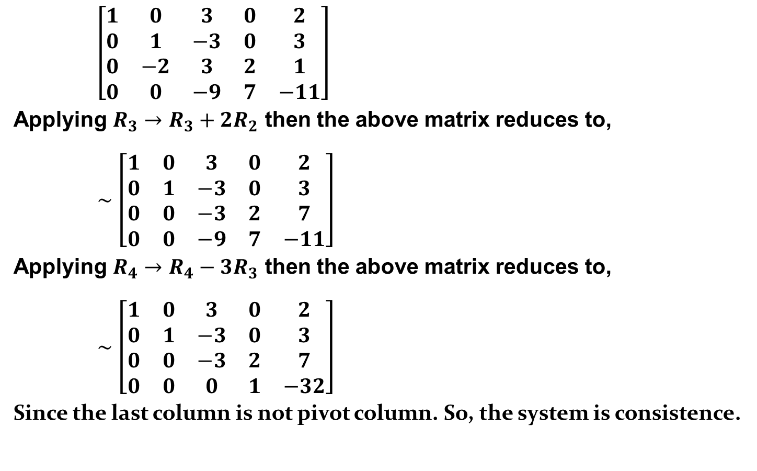
$\left[\begin{matrix}1 & 0 & 3 & 0 & 2 \\ 0 & 1 & −3 & 0 & 3 \\ 0 & −2 & 3 & 2 & 1 \\ 0 & 0 & −9 & 7 & −11\end{matrix}\right]$
Applying $R_{3}→R_{3}+2R_{2}$ then the above matrix reduces to,
$\sim$ $\left[\begin{matrix}1 & 0 & 3 & 0 & 2 \\ 0 & 1 & −3 & 0 & 3 \\ 0 & 0 & −3 & 2 & 7 \\ 0 & 0 & −9 & 7 & −11\end{matrix}\right]$
Applying $R_{4}→R_{4}−3R_{3}$ then the above matrix reduces to,
$\sim$ $\left[\begin{matrix}1 & 0 & 3 & 0 & 2 \\ 0 & 1 & −3 & 0 & 3 \\ 0 & 0 & −3 & 2 & 7 \\ 0 & 0 & 0 & 1 & −32\end{matrix}\right]$
Since the last column is not pivot column. So, the system is consistence.

Slide 25
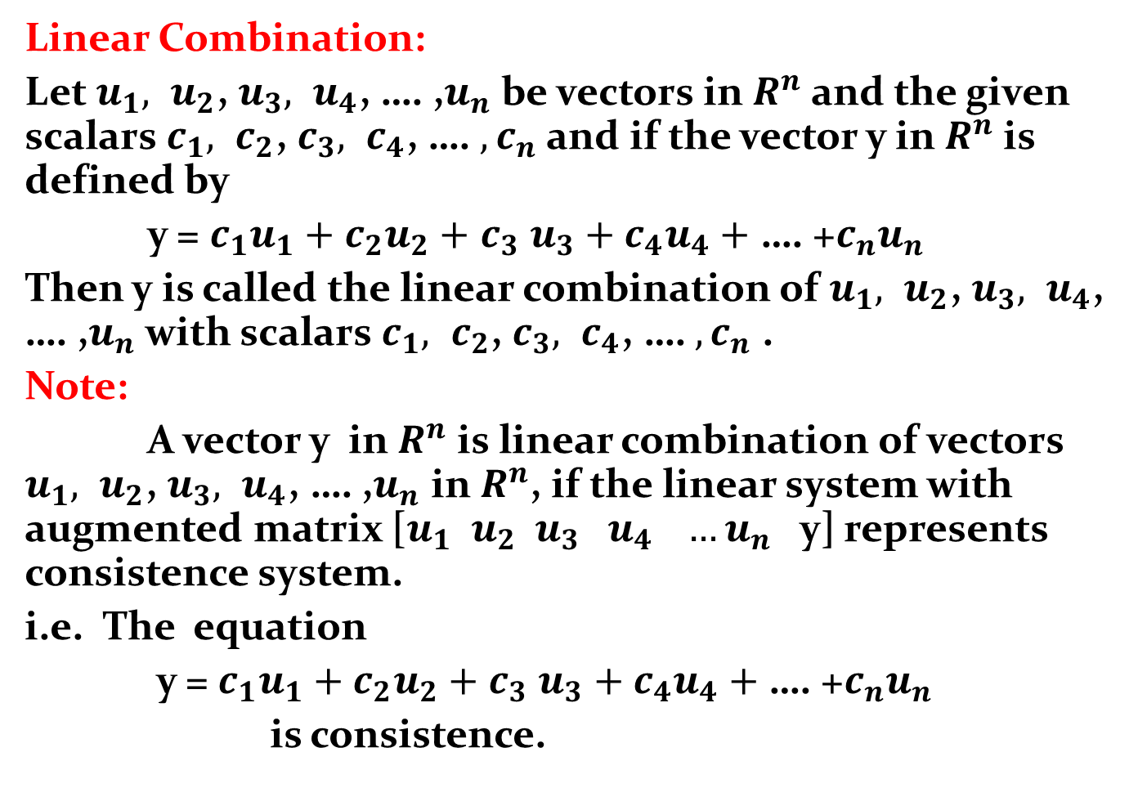
Linear Combination:
Let $u_{1}, u_{2}$, $u_{3}, u_{4}$, …. ,$u_{n}$ be vectors in $R^{n}$ and the given scalars $c_{1}, c_{2}$, $c_{3}, c_{4}$, …. ${,c}_{n}$ and if the vector y in $R^{n}$is defined by
y = $c_{1}u_{1}+c_{2}u_{2}+$ $c_{3}$ $u_{3}+{c_{4}u}_{4}+$ …. +${c_{n}u}_{n}$
Then y is called the linear combination of $u_{1}, u_{2}$, $u_{3}, u_{4}$, …. ,$u_{n}$ with scalars $c_{1}, c_{2}$, $c_{3}, c_{4}$, …. ${,c}_{n}$ .
Note:
A vector y in $R^{n}$ is linear combination of vectors $u_{1}, u_{2}$, $u_{3}, u_{4}$, …. ,$u_{n}$ in $R^{n}$, if the linear system with augmented matrix [$u_{1} u_{2} u_{3} u_{4} …u_{n}$ y] represents consistence system.
i.e. The equation
y = $c_{1}u_{1}+c_{2}u_{2}+$ $c_{3}$ $u_{3}+{c_{4}u}_{4}+$ …. +${c_{n}u}_{n}$
is consistence.

Slide 26
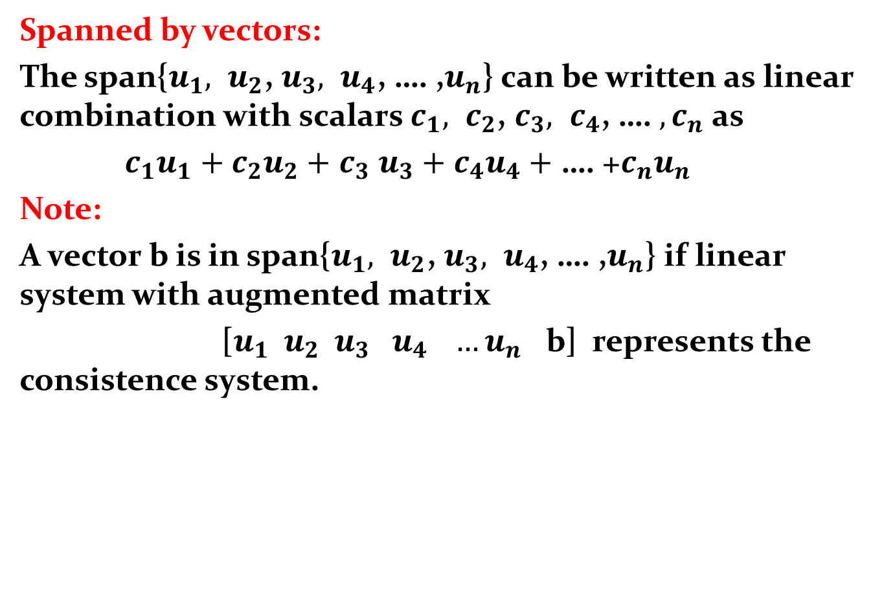
Spanned by vectors:
The span{$u_{1}, u_{2}$, $u_{3}, u_{4}$, …. ,$u_{n}$} can be written as linear combination with scalars $c_{1}, c_{2}$, $c_{3}, c_{4}$, …. ${,c}_{n}$ as
$c_{1}u_{1}+c_{2}u_{2}+$ $c_{3}$ $u_{3}+{c_{4}u}_{4}+$ …. +${c_{n}u}_{n}$
Note:
A vector b is in span{$u_{1}, u_{2}$, $u_{3}, u_{4}$, …. ,$u_{n}$} if linear system with augmented matrix
[$u_{1} u_{2} u_{3} u_{4} …u_{n}$ b] represents the consistence system.

Slide 27
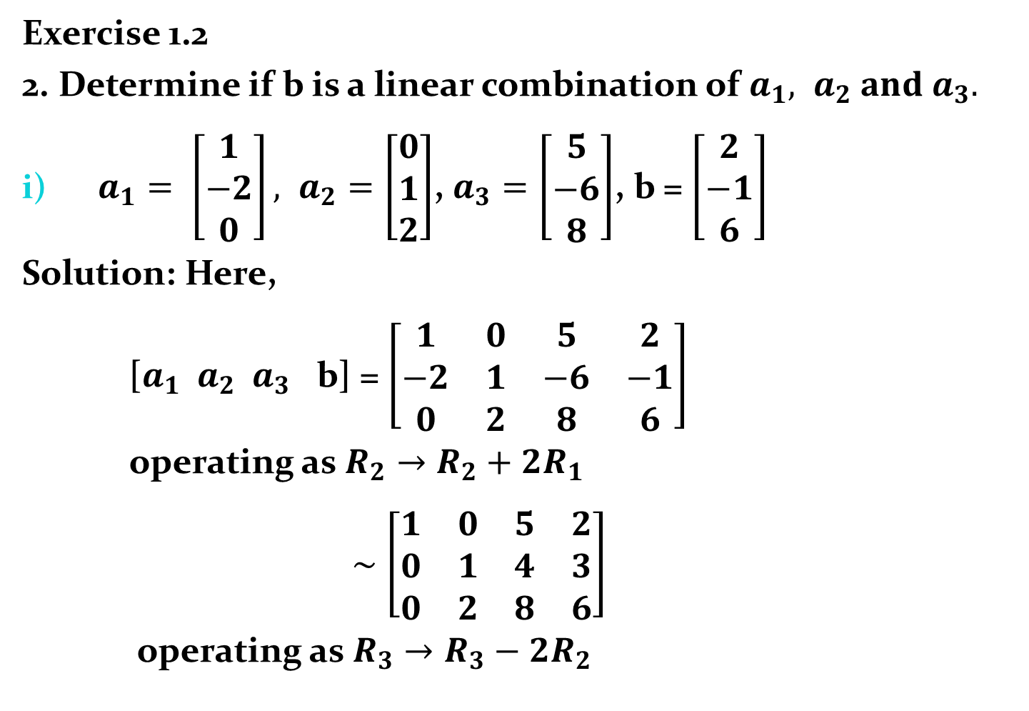
Exercise 1.2
2. Determine if b is a linear combination of $a_{1}, a_{2} and a_{3}.$
$a_{1}= \left[\begin{matrix}1 \\ −2 \\ 0\end{matrix}\right], a_{2}=\left[\begin{matrix}0 \\ 1 \\ 2\end{matrix}\right]$, $a_{3}=\left[\begin{matrix}5 \\ −6 \\ 8\end{matrix}\right]$, b = $\left[\begin{matrix}2 \\ −1 \\ 6\end{matrix}\right]$
Solution: Here,
[$a_{1} a_{2} a_{3}$ b] = $\left[\begin{matrix}1 & 0 & 5 & 2 \\ −2 & 1 & −6 & −1 \\ 0 & 2 & 8 & 6\end{matrix}\right]$
operating as $R_{2}→R_{2}+2R_{1}$
$\sim$ $\left[\begin{matrix}1 & 0 & 5 & 2 \\ 0 & 1 & 4 & 3 \\ 0 & 2 & 8 & 6\end{matrix}\right]$
operating as $R_{3}→R_{3}−2R_{2}$

Slide 28

$\sim$ $\left[\begin{matrix}1 & 0 & 5 & 2 \\ 0 & 1 & 4 & 3 \\ 0 & 0 & 0 & 0\end{matrix}\right]$
Thus the system $a_{1}x_{1}+a_{2}x_{2}+$ $a_{3}$ $x_{3}=b$ is consistent . Hence, b is linear combination of $a_{1}, a_{2} and a_{3}$.

Slide 29
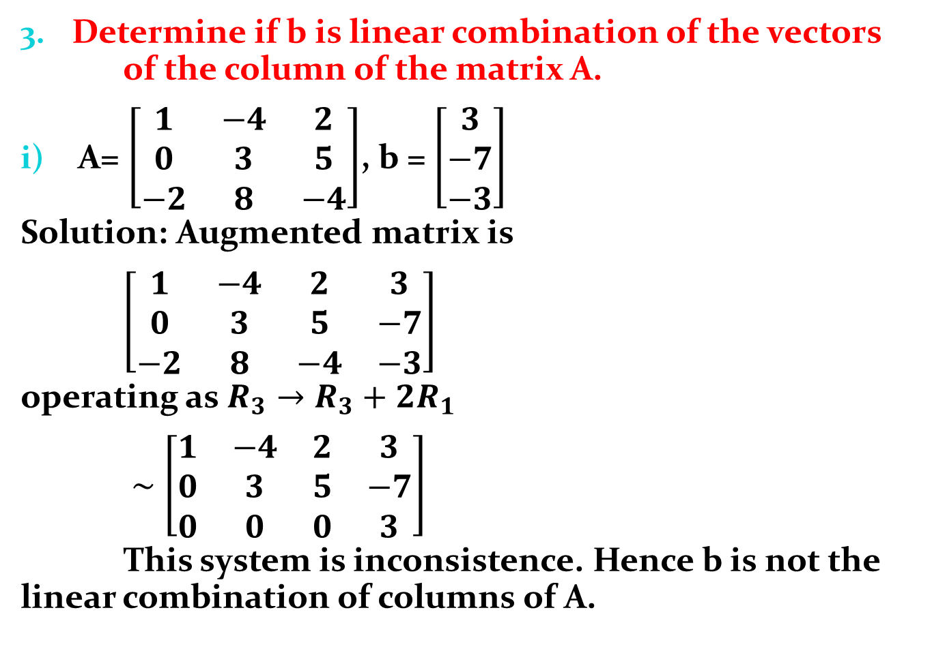
Determine if b is linear combination of the vectors of the column of the matrix A.
A= $\left[\begin{matrix}1 & −4 & 2 \\ 0 & 3 & 5 \\ −2 & 8 & −4\end{matrix}\right]$, b = $\left[\begin{matrix}3 \\ −7 \\ −3\end{matrix}\right]$
Solution: Augmented matrix is
$\left[\begin{matrix}1 & −4 & 2 & 3 \\ 0 & 3 & 5 & −7 \\ −2 & 8 & −4 & −3\end{matrix}\right]$
operating as $R_{3}→R_{3}+2R_{1}$
$\sim$ $\left[\begin{matrix}1 & −4 & 2 & 3 \\ 0 & 3 & 5 & −7 \\ 0 & 0 & 0 & 3\end{matrix}\right]$
This system is inconsistence. Hence b is not the linear combination of columns of A.

Slide 30
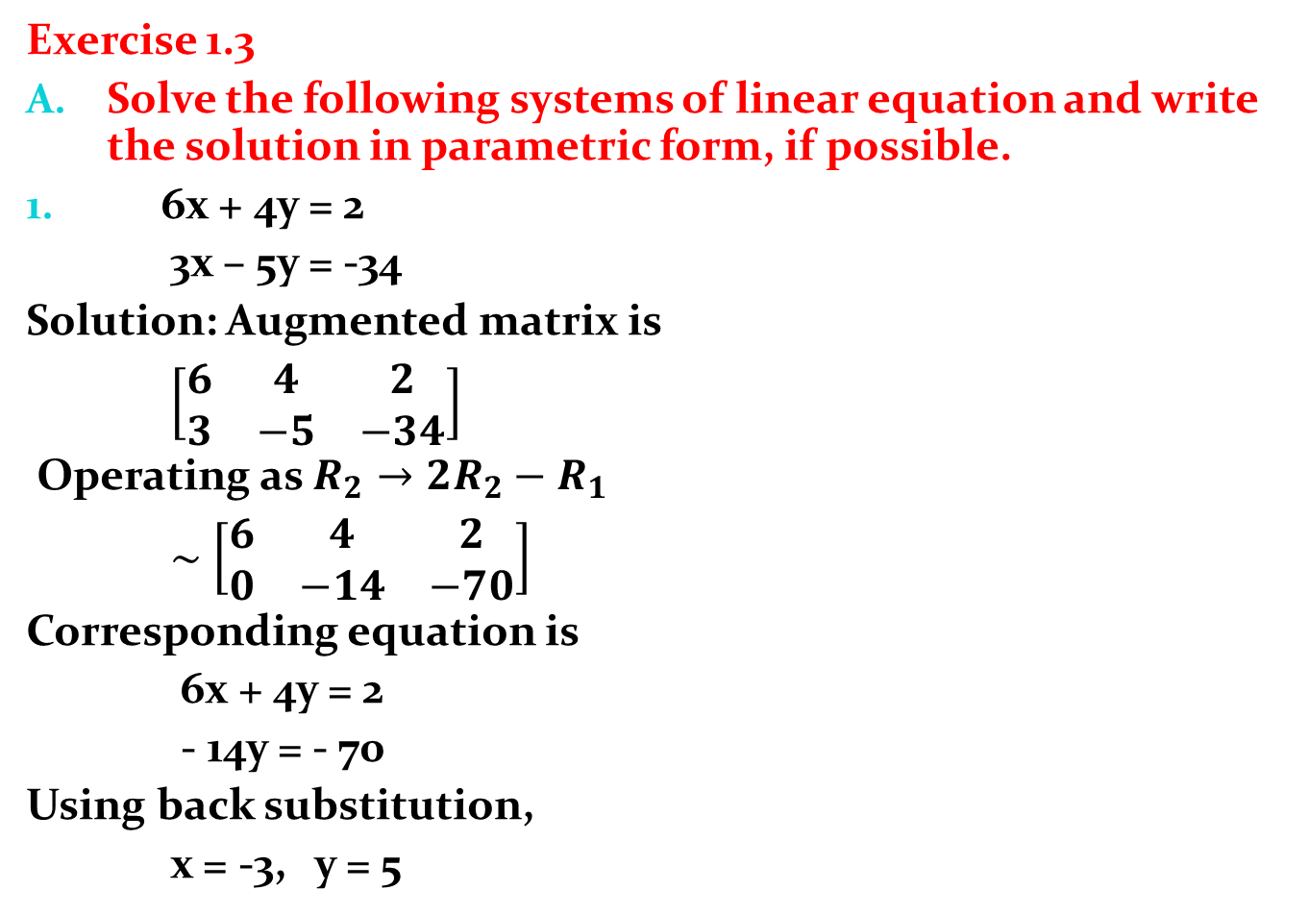
Exercise 1.3
Solve the following systems of linear equation and write the solution in parametric form, if possible.
6x + 4y = 2
3x – 5y = -34
Solution: Augmented matrix is
$\left[\begin{matrix}6 & 4 & 2 \\ 3 & −5 & −34\end{matrix}\right]$
Operating as $R_{2}→{2R}_{2}−R_{1}$
$\sim$ $\left[\begin{matrix}6 & 4 & 2 \\ 0 & −14 & −70\end{matrix}\right]$
Corresponding equation is
6x + 4y = 2
- 14y = - 70
Using back substitution,
x = -3, y = 5

Slide 31
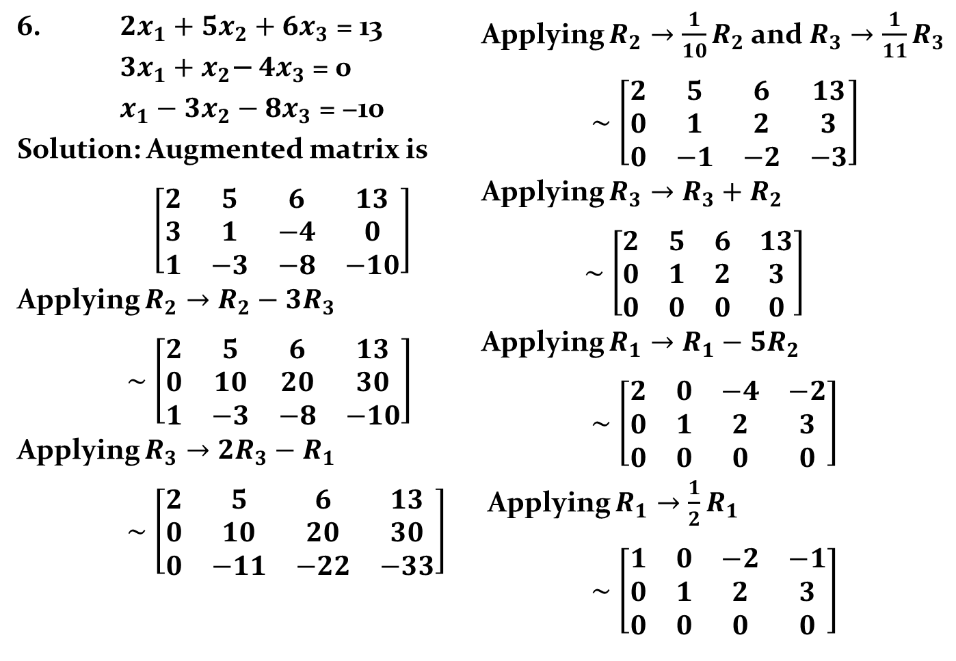
6. ${2x}_{1}+5x_{2}+6x_{3}\text{ = }\text{13}$
$3x_{1}+x_{2}\text{− }4x_{3}\text{ = }\text{0}$
$x_{1}−3x_{2}−8x_{3}\text{ = }\text{−}\text{1}\text{0}$
Solution: Augmented matrix is
$\left[\begin{matrix}2 & 5 & 6 & 13 \\ 3 & 1 & −4 & 0 \\ 1 & −3 & −8 & −10\end{matrix}\right]$
Applying $R_{2}→R_{2}−3R_{3}$
$\sim$ $\left[\begin{matrix}2 & 5 & 6 & 13 \\ 0 & 10 & 20 & 30 \\ 1 & −3 & −8 & −10\end{matrix}\right]$
Applying $R_{3}→{2R}_{3}−R_{1}$
$\sim$ $\left[\begin{matrix}2 & 5 & 6 & 13 \\ 0 & 10 & 20 & 30 \\ 0 & −11 & −22 & −33\end{matrix}\right]$
Applying $R_{2}→{\frac{1}{10}R}_{2}$ and $R_{3}→{\frac{1}{11}R}_{3}$
$\sim$ $\left[\begin{matrix}2 & 5 & 6 & 13 \\ 0 & 1 & 2 & 3 \\ 0 & −1 & −2 & −3\end{matrix}\right]$
Applying $R_{3}→R_{3}+R_{2}$
$\sim$ $\left[\begin{matrix}2 & 5 & 6 & 13 \\ 0 & 1 & 2 & 3 \\ 0 & 0 & 0 & 0\end{matrix}\right]$
Applying $R_{1}→R_{1}−5R_{2}$
$\sim$ $\left[\begin{matrix}2 & 0 & −4 & −2 \\ 0 & 1 & 2 & 3 \\ 0 & 0 & 0 & 0\end{matrix}\right]$
Applying $R_{1}→{\frac{1}{2}R}_{1}$
$\sim$ $\left[\begin{matrix}1 & 0 & −2 & −1 \\ 0 & 1 & 2 & 3 \\ 0 & 0 & 0 & 0\end{matrix}\right]$

Slide 32
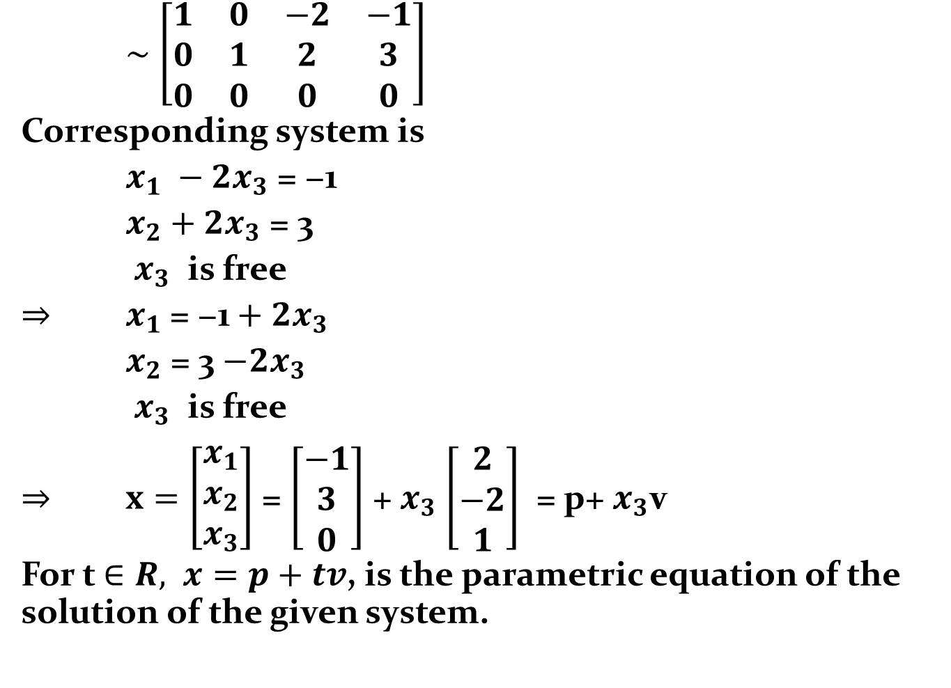
$\sim$ $\left[\begin{matrix}1 & 0 & −2 & −1 \\ 0 & 1 & 2 & 3 \\ 0 & 0 & 0 & 0\end{matrix}\right]$
Corresponding system is
$x_{1} −2x_{3}\text{ = }\text{−}\text{1}$
$x_{2}+{2x}_{3} \text{= }\text{3}$
$x_{3}$ is free
$⇒$ $x_{1} \text{= −1}+2x_{3}$
$x_{2}\text{ = 3}$ $−2x_{3}$
$x_{3}$ is free
$⇒$ $x=\left[\begin{matrix}x_{1} \\ x_{2} \\ x_{3}\end{matrix}\right]$ = $\left[\begin{matrix}−1 \\ 3 \\ 0\end{matrix}\right]$ + $x_{3}$ $\left[\begin{matrix}2 \\ −2 \\ 1\end{matrix}\right]$ = p+ $x_{3}$v
For t $∈R,$ $x=p+tv$, is the parametric equation of the solution of the given system.

Slide 33
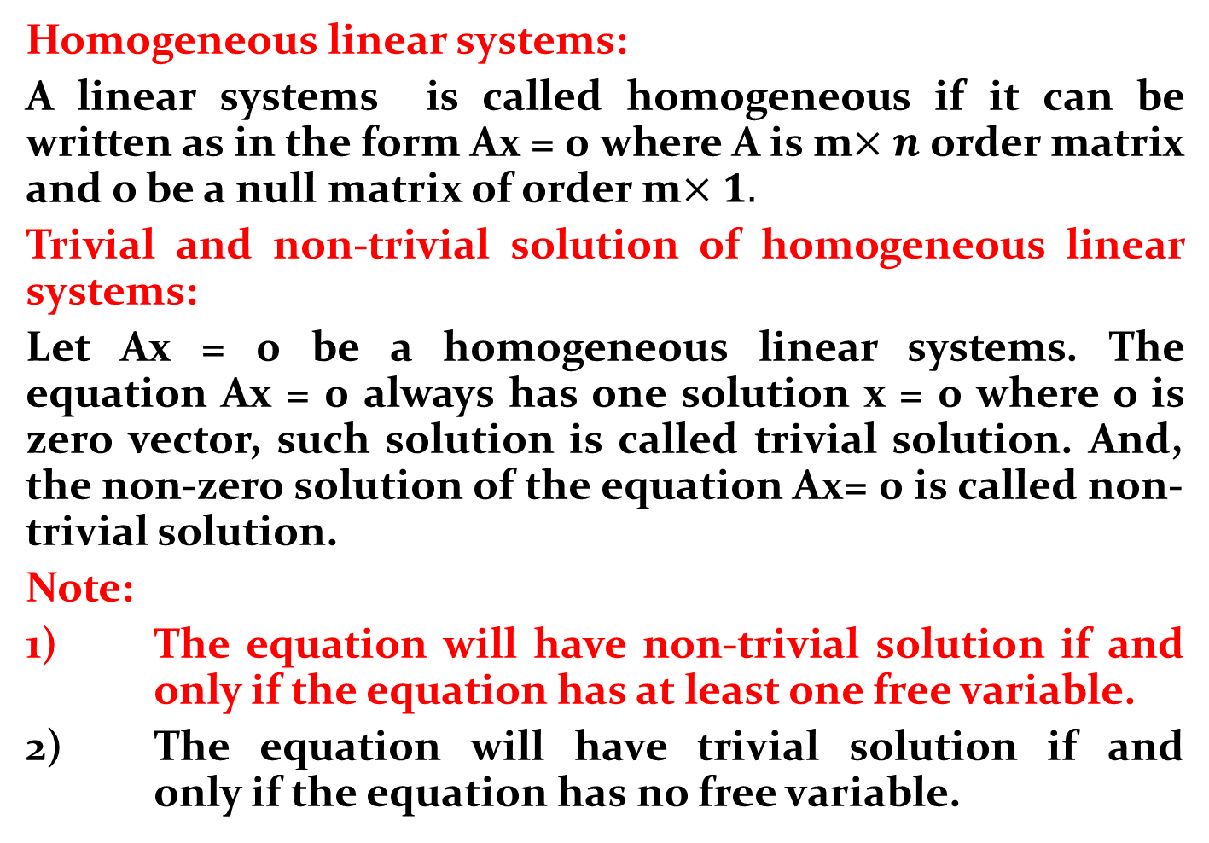
Homogeneous linear systems:
A linear systems is called homogeneous if it can be written as in the form Ax = 0 where A is m$×n$ order matrix and o be a null matrix of order m$×1.$
Trivial and non-trivial solution of homogeneous linear systems:
Let Ax = 0 be a homogeneous linear systems. The equation Ax = 0 always has one solution x = 0 where o is zero vector, such solution is called trivial solution. And, the non-zero solution of the equation Ax= 0 is called non-trivial solution.
Note:
1) The equation will have non-trivial solution if and only if the equation has at least one free variable.
2) The equation will have trivial solution if and only if the equation has no free variable.

Slide 34
If the equation Ax = 0 has only one free variable, then the solution set is a line through origin.
If the equation Ax = 0 has only two free variables, then the solution set is a plane containing origin.
If the equation Ax = 0 has only o as its solution then the solution set is span {0} and it is a point origin.

Slide 35
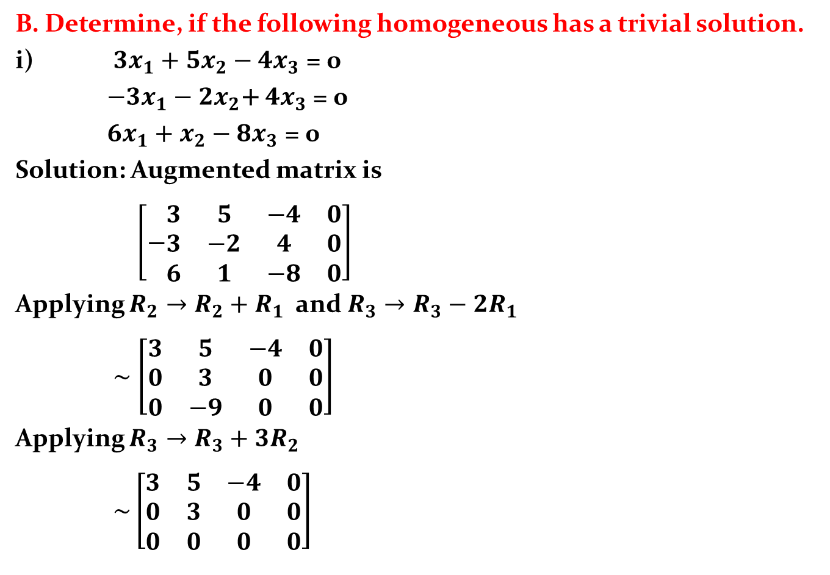
B. Determine, if the following homogeneous has a trivial solution.
i) ${3x}_{1}+5x_{2}−4x_{3}\text{ = }\text{0}$
$−3x_{1}−2x_{2}\text{+} 4x_{3}\text{ = 0}$
${6x}_{1}+x_{2}−8x_{3}\text{ = 0}$
Solution: Augmented matrix is
$\left[−\begin{matrix}3 & 5 & −4 & 0 \\ 3 & −2 & 4 & 0 \\ 6 & 1 & −8 & 0\end{matrix}\right]$
Applying $R_{2}→R_{2}+R_{1}$ and $R_{3}→R_{3}−{2R}_{1}$
$\sim$ $\left[\begin{matrix}3 & 5 & −4 & 0 \\ 0 & 3 & 0 & 0 \\ 0 & −9 & 0 & 0\end{matrix}\right]$
Applying $R_{3}→R_{3}+{3R}_{2}$
$\sim \left[\begin{matrix}3 & 5 & −4 & 0 \\ 0 & 3 & 0 & 0 \\ 0 & 0 & 0 & 0\end{matrix}\right]$

Slide 36
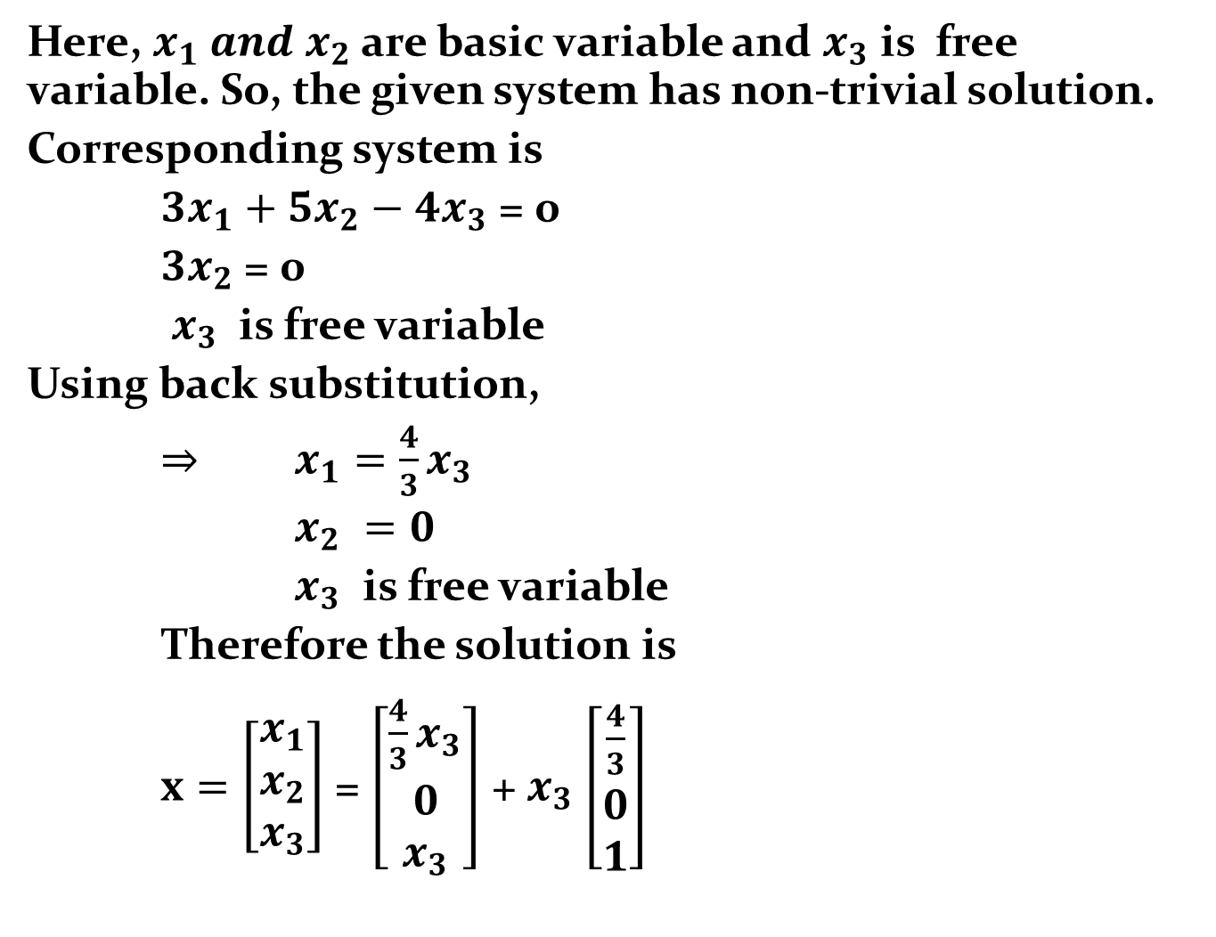
Here, $x_{1} and x_{2}$ are basic variable and $x_{3}$ is free variable. So, the given system has non-trivial solution.
Corresponding system is
${3x}_{1}+5x_{2}−4x_{3}\text{ = 0}$
$3x_{2} \text{= 0}$
$x_{3}$ is free variable
Using back substitution,
$⇒$ $x_{1}=\frac{4}{3}x_{3}$
$x_{2} =0$
$x_{3}$ is free variable
Therefore the solution is
$x=\left[\begin{matrix}x_{1} \\ x_{2} \\ x_{3}\end{matrix}\right]$ = $\left[\begin{matrix}\frac{4}{3}x_{3} \\ 0 \\ x_{3}\end{matrix}\right]$ + $x_{3}$ $\left[\begin{matrix}\frac{4}{3} \\ 0 \\ 1\end{matrix}\right]$

Slide 37
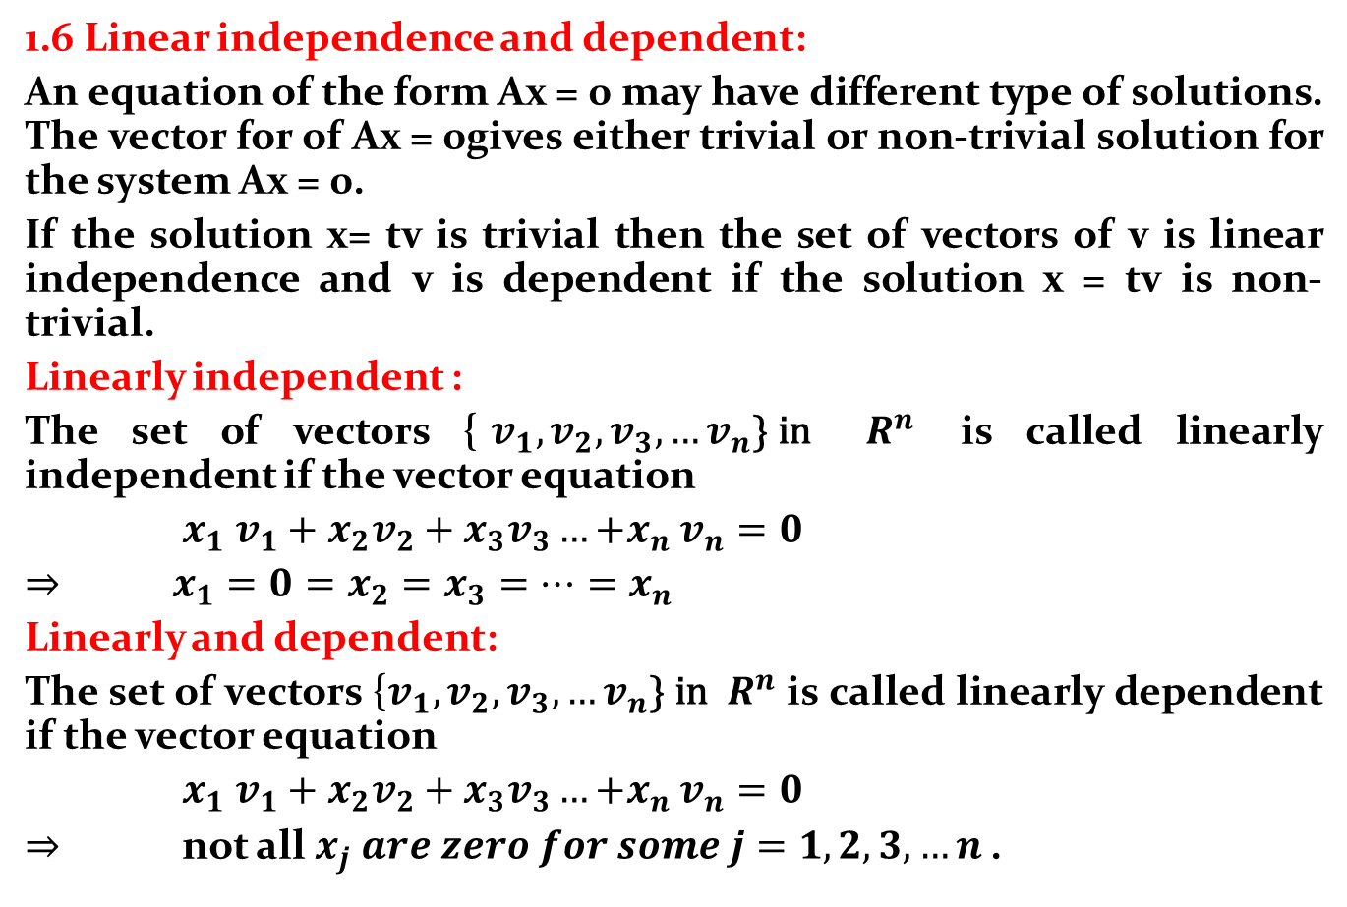
1.6 Linear independence and dependent:
An equation of the form Ax = 0 may have different type of solutions. The vector for of Ax = 0gives either trivial or non-trivial solution for the system Ax = 0.
If the solution x= tv is trivial then the set of vectors of v is linear independence and v is dependent if the solution x = tv is non-trivial.
Linearly independent :
The set of vectors {$v_{1}, v_{2}, v_{3}, …v_{n}\text{\} }\text{in}$ $R^{n}$ is called linearly independent if the vector equation
${x_{1} v_{1}+x_{2}v_{2}+x}_{3}v_{3}…{+x}_{n}v_{n}=0$
$⇒$ ${x_{1}=0=x_{2}=x}_{3}=…{=x}_{n}$
Linearly and dependent:
The set of vectors {$v_{1}, v_{2}, v_{3}, …v_{n}\text{\} }\text{in}$ $R^{n}$ is called linearly dependent if the vector equation
${x_{1} v_{1}+x_{2}v_{2}+x}_{3}v_{3}…{+x}_{n}v_{n}=0$
$⇒$ not all ${x_{j} are zero for some j=1, 2, 3, …n}_{ }$.

Slide 38
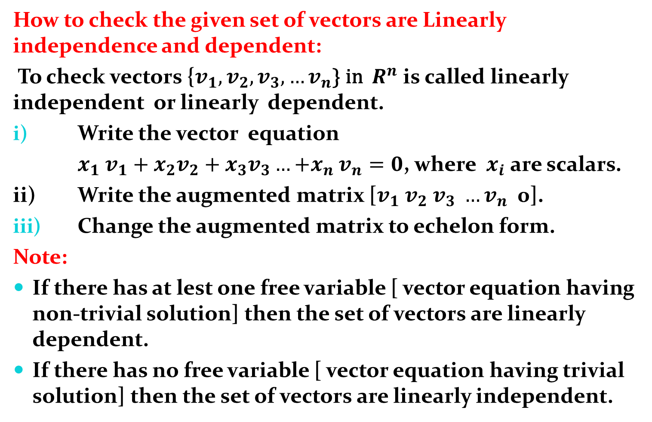
How to check the given set of vectors are Linearly independence and dependent:
To check vectors {$v_{1}, v_{2}, v_{3}, …v_{n}\text{\} }\text{in}$ $R^{n}$ is called linearly independent or linearly dependent.
Write the vector equation
${x_{1} v_{1}+x_{2}v_{2}+x}_{3}v_{3}…{+x}_{n}v_{n}=0$, where $x_{i}$ are scalars.
ii) Write the augmented matrix [$v_{1} v_{2} v_{3} …v_{n}$ 0].
Change the augmented matrix to echelon form.
Note:
If there has at lest one free variable [ vector equation having non-trivial solution] then the set of vectors are linearly dependent.
If there has no free variable [ vector equation having trivial solution] then the set of vectors are linearly independent.

Slide 39
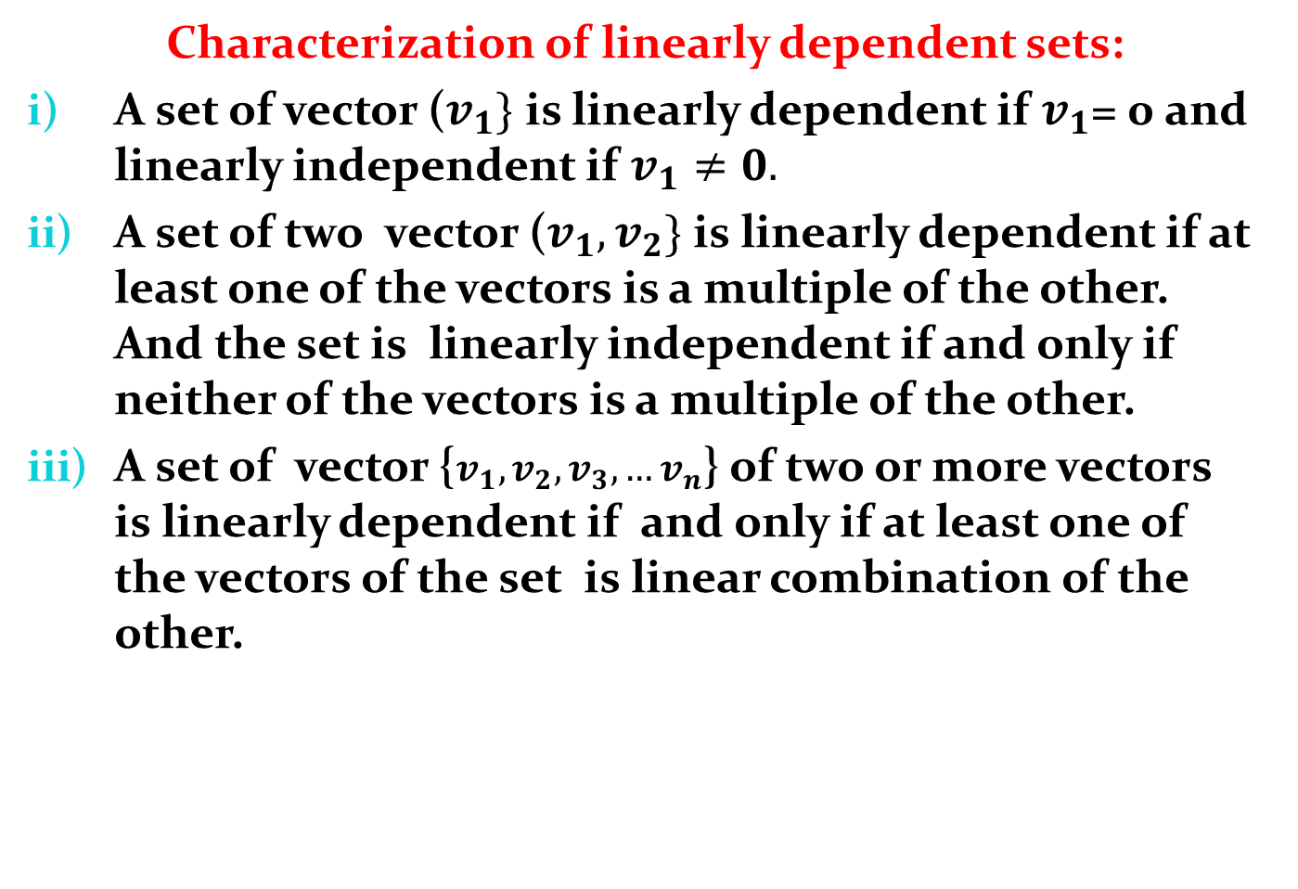
Characterization of linearly dependent sets:
A set of vector ($v_{1}\}$ is linearly dependent if $v_{1}$= 0 and linearly independent if $v_{1}≠0.$
A set of two vector ($v_{1},v_{2}\}$ is linearly dependent if at least one of the vectors is a multiple of the other. And the set is linearly independent if and only if neither of the vectors is a multiple of the other.
A set of vector {$v_{1},v_{2},v_{3},…v_{n}$} of two or more vectors is linearly dependent if and only if at least one of the vectors of the set is linear combination of the other.

Slide 40
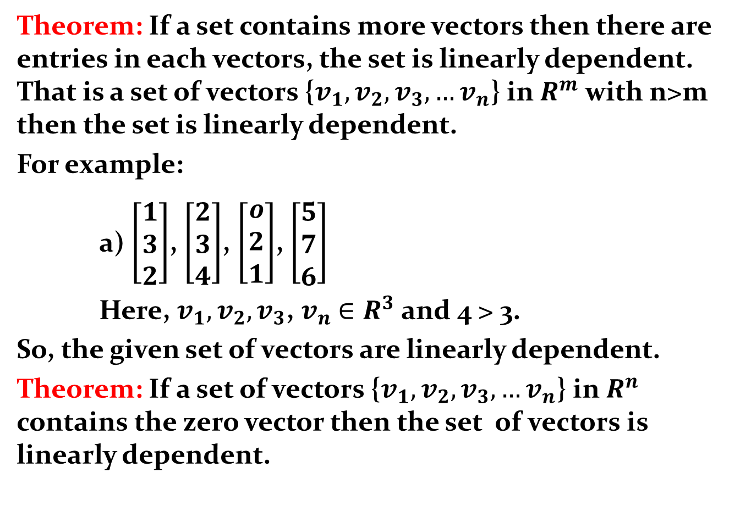
Theorem: If a set contains more vectors then there are entries in each vectors, the set is linearly dependent. That is a set of vectors {$v_{1},v_{2},v_{3},…v_{n}$} in $R^{m}$ with n>m then the set is linearly dependent.
For example:
a) $\left[\begin{matrix}1 \\ 3 \\ 2\end{matrix}\right]$, $\left[\begin{matrix}2 \\ 3 \\ 4\end{matrix}\right]$, $\left[\begin{matrix}o \\ 2 \\ 1\end{matrix}\right]$, $\left[\begin{matrix}5 \\ 7 \\ 6\end{matrix}\right]$
Here, $v_{1},v_{2},v_{3}$, $v_{n}$ $∈R^{3}$ and 4 > 3.
So, the given set of vectors are linearly dependent.
Theorem: If a set of vectors {$v_{1},v_{2},v_{3},…v_{n}$} in $R^{n}$ contains the zero vector then the set of vectors is linearly dependent.

Slide 41
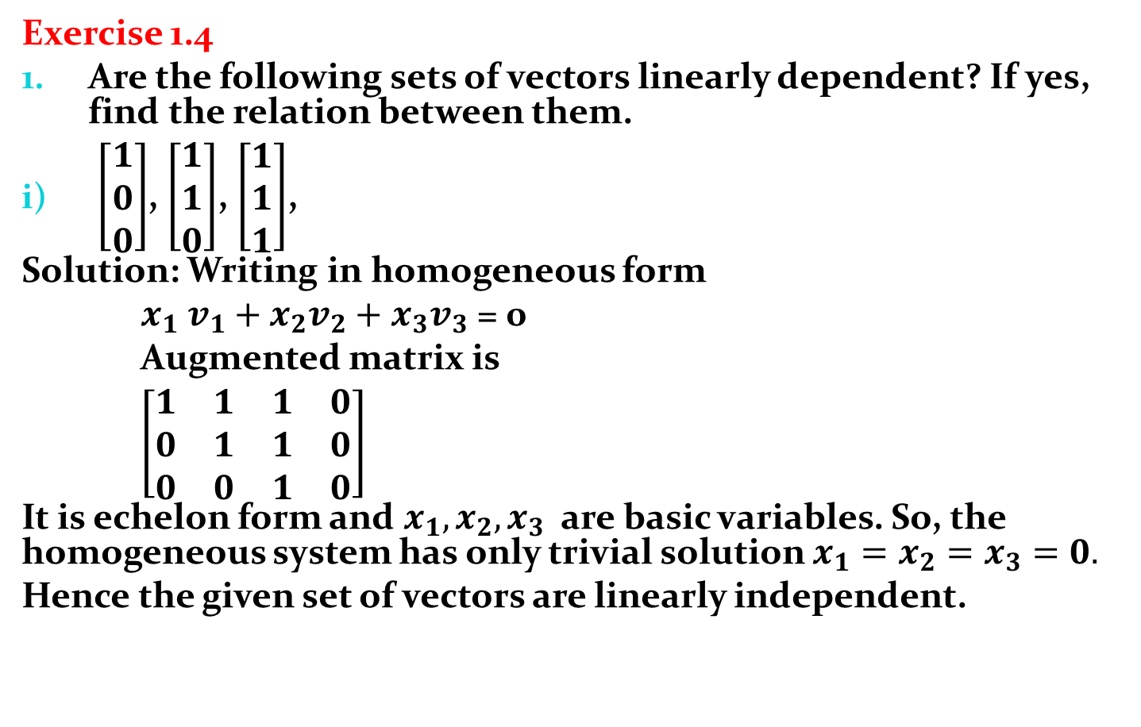
Exercise 1.4
Are the following sets of vectors linearly dependent? If yes, find the relation between them.
$\left[\begin{matrix}1 \\ 0 \\ 0\end{matrix}\right]$, $\left[\begin{matrix}1 \\ 1 \\ 0\end{matrix}\right]$, $\left[\begin{matrix}1 \\ 1 \\ 1\end{matrix}\right]$,
Solution: Writing in homogeneous form
${x_{1} v_{1}+x_{2}v_{2}+x}_{3}v_{3}$ = 0
Augmented matrix is
$\left[\begin{matrix}1 & 1 & 1 & 0 \\ 0 & 1 & 1 & 0 \\ 0 & 0 & 1 & 0\end{matrix}\right]$
It is echelon form and $x_{1},x_{2},x_{3}$ are basic variables. So, the homogeneous system has only trivial solution $x_{1}=x_{2}=x_{3}=0.$
Hence the given set of vectors are linearly independent.

Slide 42

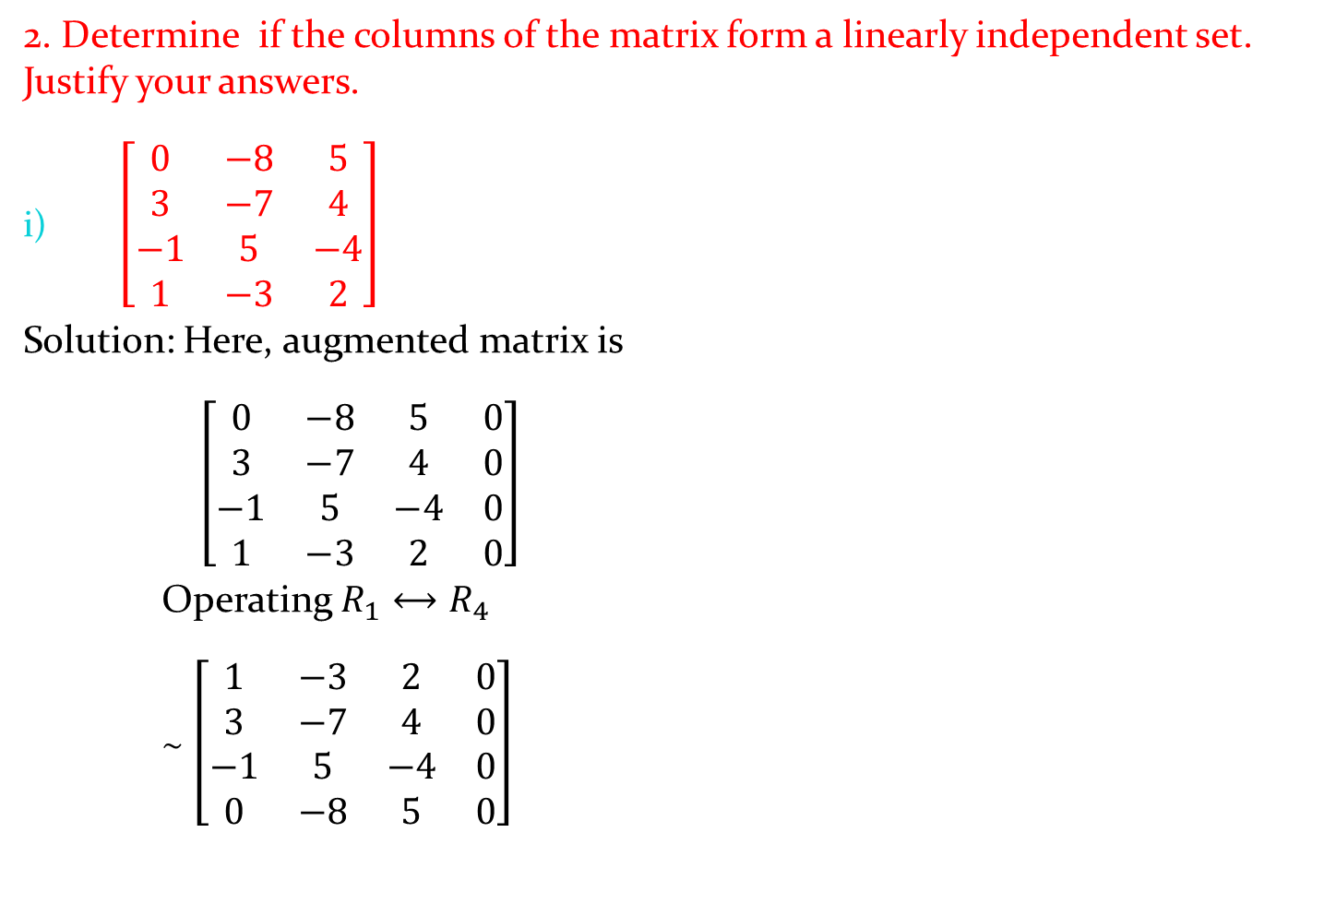
2. Determine if the columns of the matrix form a linearly independent set. Justify your answers.
$\left[\begin{matrix}0 & −8 & 5 \\ 3 & −7 & 4 \\ −1 & 5 & −4 \\ 1 & −3 & 2\end{matrix}\right]$
Solution: Here, augmented matrix is
$\left[\begin{matrix}0 & −8 & 5 & 0 \\ 3 & −7 & 4 & 0 \\ −1 & 5 & −4 & 0 \\ 1 & −3 & 2 & 0\end{matrix}\right]$
Operating $R_{1}⟷R_{4}$
$\sim$ $\left[\begin{matrix}1 & −3 & 2 & 0 \\ 3 & −7 & 4 & 0 \\ −1 & 5 & −4 & 0 \\ 0 & −8 & 5 & 0\end{matrix}\right]$
Operating $R_{2}→ R_{2}−3$ $R_{1}$ and $R_{3}→R_{3}+$ $R_{2}$
$\sim$ $\left[\begin{matrix}1 & −3 & 2 & 0 \\ 0 & 7 & −2 & 0 \\ 0 & 2 & −2 & 0 \\ 0 & −8 & 5 & 0\end{matrix}\right]$
Applying $R_{3}→{\frac{1}{2}R}_{3}$
$\sim$ $\left[\begin{matrix}1 & −3 & 2 & 0 \\ 0 & 7 & −2 & 0 \\ 0 & 1 & −1 & 0 \\ 0 & −8 & 5 & 0\end{matrix}\right]$

Slide 43
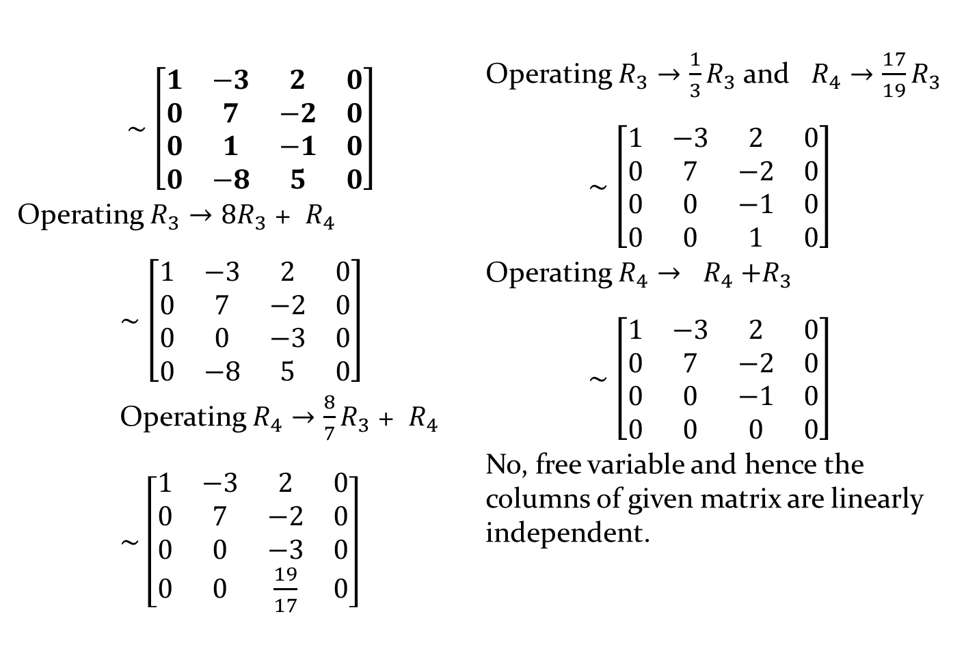
$\sim$ $\left[\begin{matrix}1 & −3 & 2 & 0 \\ 0 & 7 & −2 & 0 \\ 0 & 1 & −1 & 0 \\ 0 & −8 & 5 & 0\end{matrix}\right]$
Operating $R_{3}→{8R}_{3}$ + $R_{4}$
$\sim$ $\left[\begin{matrix}1 & −3 & 2 & 0 \\ 0 & 7 & −2 & 0 \\ 0 & 0 & −3 & 0 \\ 0 & −8 & 5 & 0\end{matrix}\right]$
Operating $R_{4}→{\frac{8}{7}R}_{3}$ + $R_{4}$
$\sim$ $\left[\begin{matrix}1 & −3 & 2 & 0 \\ 0 & 7 & −2 & 0 \\ 0 & 0 & −3 & 0 \\ 0 & 0 & \frac{19}{17} & 0\end{matrix}\right]$
Operating $R_{3}→{\frac{1}{3}R}_{3}$ and $R_{4}→{\frac{17}{19}R}_{3}$
$\sim$ $\left[\begin{matrix}1 & −3 & 2 & 0 \\ 0 & 7 & −2 & 0 \\ 0 & 0 & −1 & 0 \\ 0 & 0 & 1 & 0\end{matrix}\right]$
Operating $R_{4}→$ $R_{4}$ ${+R}_{3}$
$\sim$ $\left[\begin{matrix}1 & −3 & 2 & 0 \\ 0 & 7 & −2 & 0 \\ 0 & 0 & −1 & 0 \\ 0 & 0 & 0 & 0\end{matrix}\right]$
No, free variable and hence the columns of given matrix are linearly independent.

Slide 44
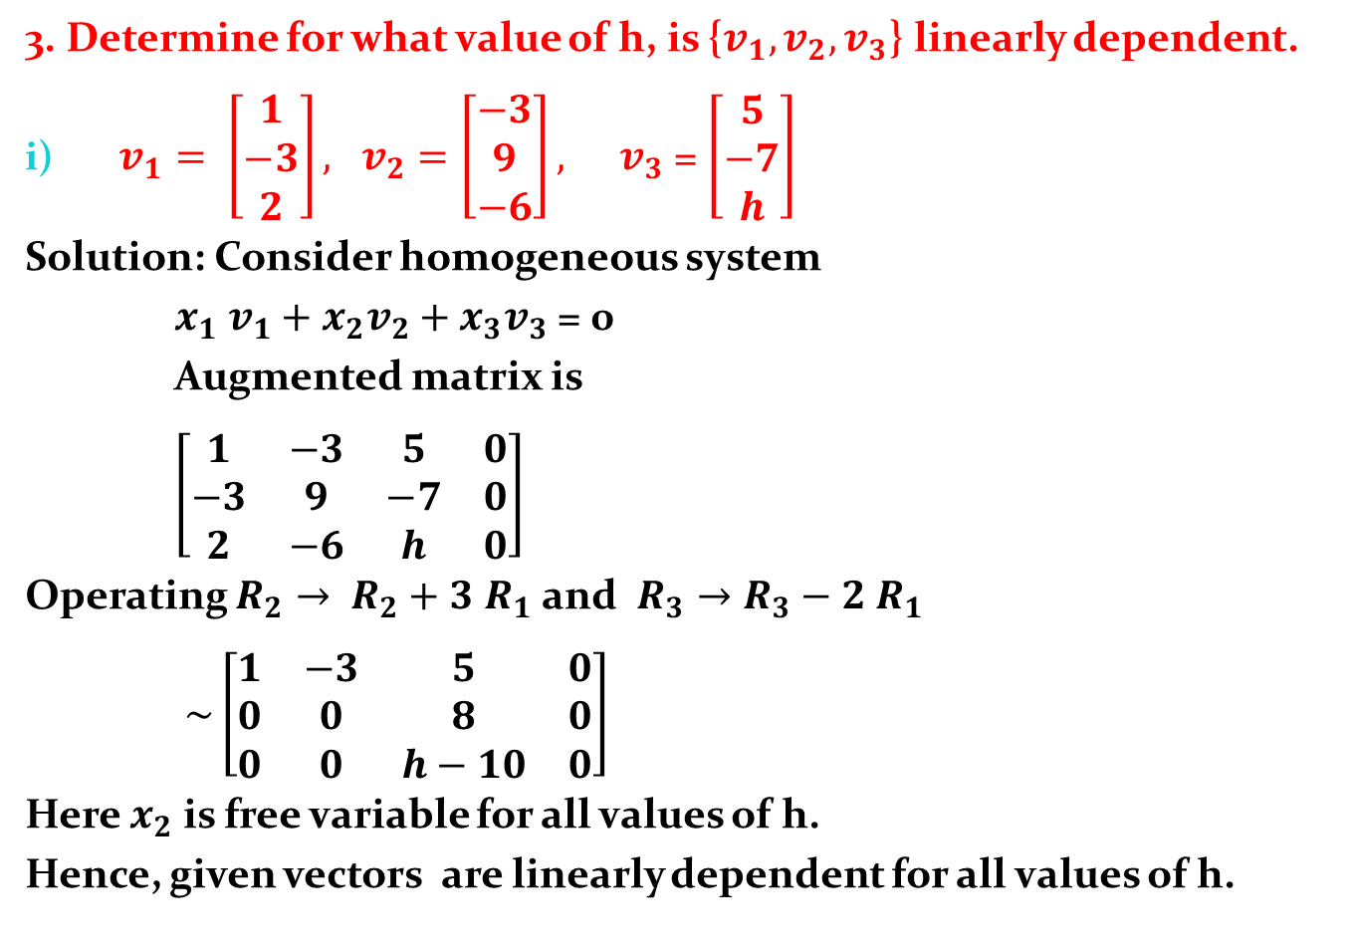
3. Determine for what value of h, is {$v_{1},v_{2},v_{3}$} linearly dependent.
$v_{1}= \left[\begin{matrix}1 \\ −3 \\ 2\end{matrix}\right], v_{2}=\left[\begin{matrix}−3 \\ 9 \\ −6\end{matrix}\right], { v}_{3}$ = $\left[\begin{matrix}5 \\ −7 \\ h\end{matrix}\right]$
Solution: Consider homogeneous system
${x_{1} v_{1}+x_{2}v_{2}+x}_{3}v_{3}$ = 0
Augmented matrix is
$\left[\begin{matrix}1 & −3 & 5 & 0 \\ −3 & 9 & −7 & 0 \\ 2 & −6 & h & 0\end{matrix}\right]$
Operating $R_{2}→ R_{2}+3$ $R_{1}$ and $R_{3}→R_{3}−2$ $R_{1}$
$\sim \left[\begin{matrix}1 & −3 & 5 & 0 \\ 0 & 0 & 8 & 0 \\ 0 & 0 & h−10 & 0\end{matrix}\right]$
Here $x_{2}$ is free variable for all values of h.
Hence, given vectors are linearly dependent for all values of h.

